Slide 1
2015 Durham County Cares Campaign
Recipient Organization Presentations
Thursday, September 17, 2015

Slide 2
2015 Durham County Cares Recipient Organizations
Community & Family Prosperity
Durham Rescue Mission
John Avery Boys & Girls Club
Health & Well-Being for All
Exchange Family Center/Exchange Clubs' Child Abuse Prevention Center
Senior PharmAssist, Inc.
Safe & Secure Community
Salvation Army Boys & Girls Club of Durham
Durham Crisis Response Center
Environmental Stewardship
Environmental Federation of North Carolina DBA: EarthShare North Carolina
Toxic Free NC
Miscellaneous/Multiple Area Services
Durham Center for Senior Life
United Way of the Greater Triangle

Slide 3
EarthShare of NC

Slide 4
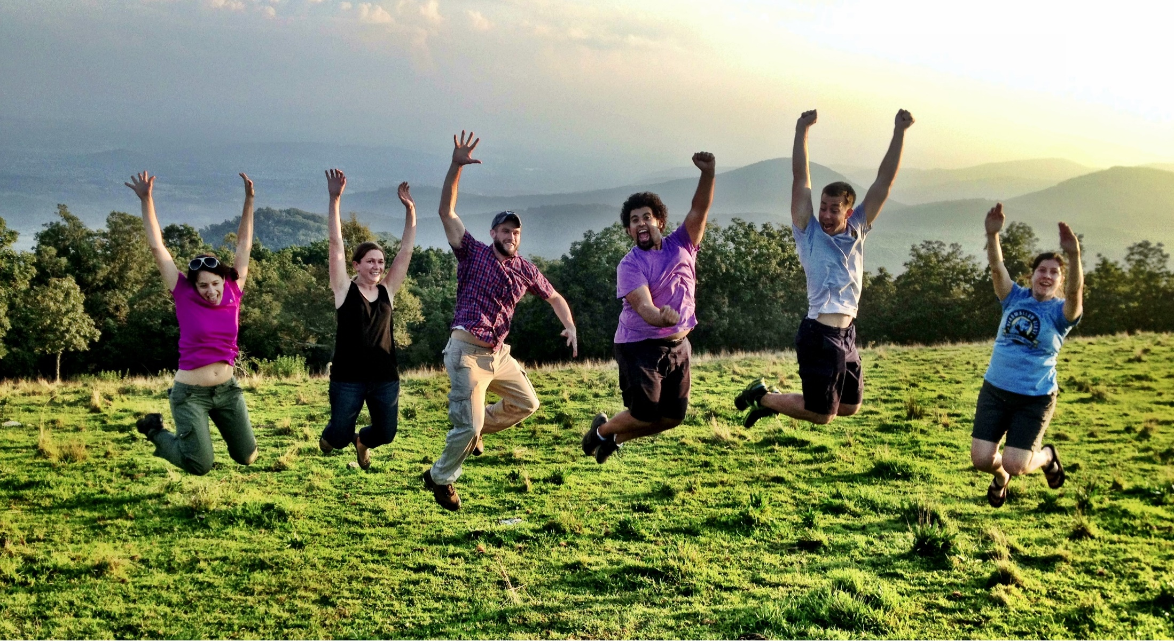

Slide 5
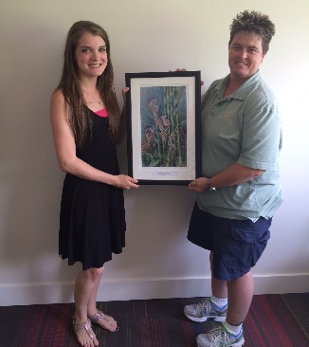
WHAT WE DO
GIVING & ENGAGEMENT
Workplace Partners
30 NC Member Nonprofits
Notes:
We connect you to conservation nonprofits through giving (Wyrick Angel Fund) and volunteering (group or individual opportunities).

Slide 6
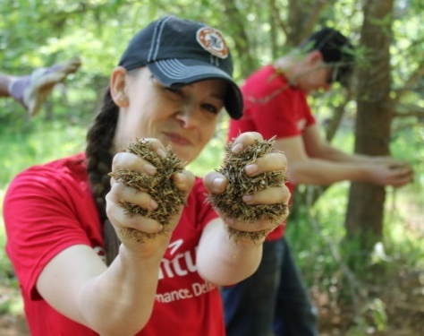
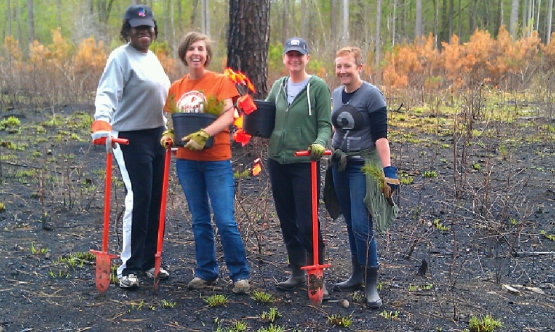
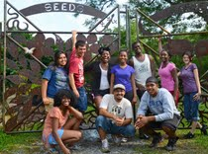
What is EarthShare NC?
NC nonprofit with 25 years of experience
Founded by its member nonprofits
Members represent more than 30 screened & trusted conservation nonprofits
Through employee engagement and giving programs EarthShare NC connects business and employees with conservation causes
Notes:
ESNC was founded by its environmental and conservation member charities to represent them in workplace giving campaigns and sustain the NC nonprofits caring for the natural resources that make NC such a strong and special place. While workplace giving remains a cornerstone program, today we provide a range of tools to connect employees with conservation.

Slide 7
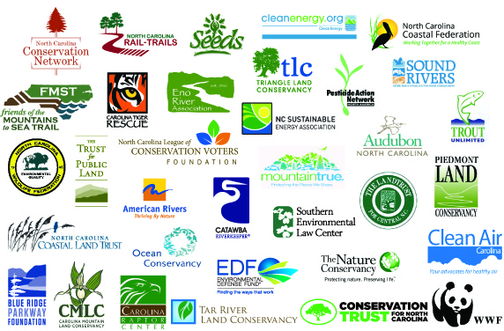
Who is EarthShare North Carolina?
Notes:
Water, air, land, wildlife. If it has to do with our natural resources, we have a Member working on it. From youth camps to land preservation, from policy to research, from the mountains to the coast, we are working at all levels to keep NC great.

Slide 8
WATER

Slide 9
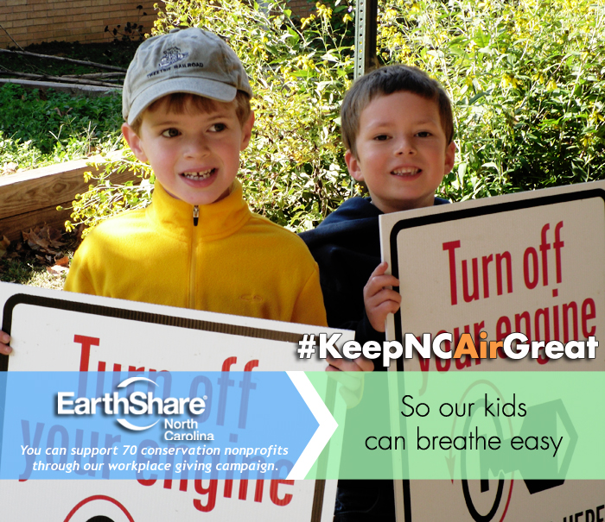
AIR
Notes:
NC League of Conservation Voters Foundation
ensuring voters understand that taking part in the democratic process is essential to protecting our clean air, safe water and quality of life in NC
Clean Air Carolinas
Children who grow up breathing polluted air have reduced lung capacity by 15-20%. Responses include:
Program to reduce diesel exhaust (40 toxic compounds associated with health impacts including asthma, heart and lung diseases, cancer.)
Retrofitting school busses
Engaging the medical community

Slide 10
LAND

Slide 11
WILDLIFE

Slide 12
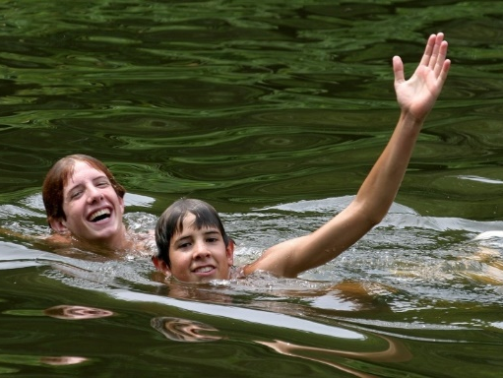
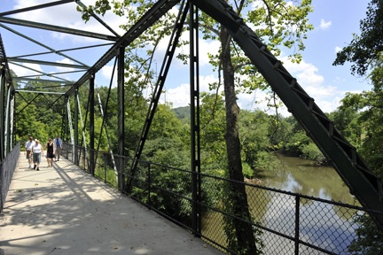
LOCAL IMPACT

Slide 14
CLICK HERE
TO DONATE NOW

