Slide 1
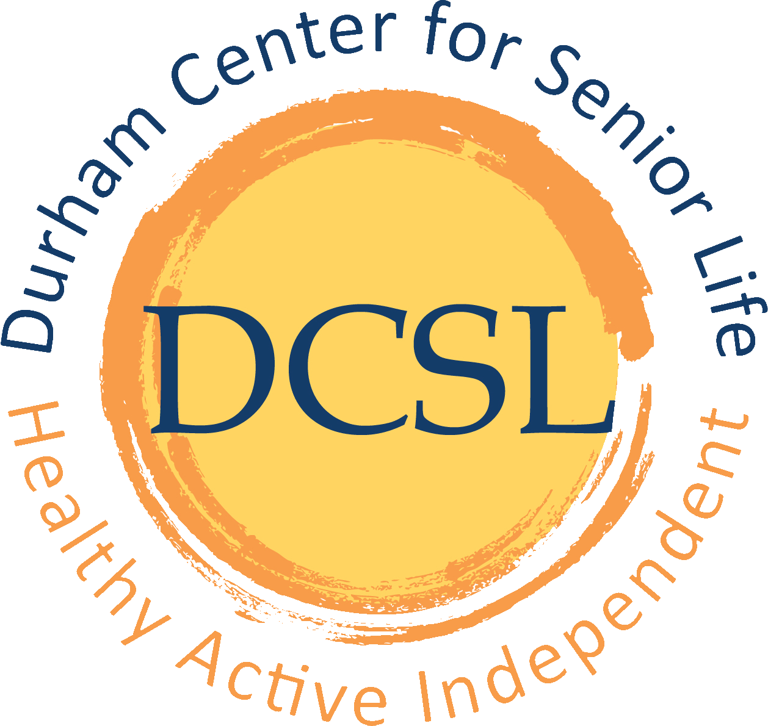
Durham Center for Senior Life thanks Durham County Cares!

Slide 2
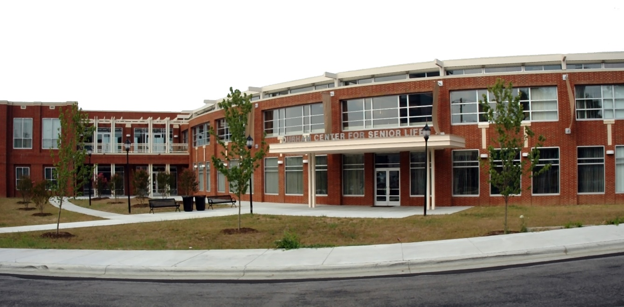
Durham Center for Senior Life’s main center is located downtown.

Slide 3
Mission Statement
"Enhancing the lives of older adults through education, recreation, nutrition and social services in welcoming community settings."
Notes:
We have 400 people pass through our Senior Center on Rigsbee every week for activities and receive 4,200 contacts for information and referral to find solutions for problems they face at the right time.

Slide 4
DCSL PROGRAMS
Adult Day Health
Senior Centers
Disease Prevention/Health Promotions
Congregate Nutrition
Senior Support Services
Information and Assistance
Options Counseling
Transportation
Family Caregiver Program

Slide 5
Senior Center Activities (HCCBG, Durham County)
Ages 55+
Activities
Exercise and dance classes
Arts & Crafts
Movies
Pool, exercise equipment
Cards and games
Special events
973 participants participate in exercise classes here annually
Notes:
Participants have reported that these exercise classes help them lose weight, take less medicine and do more than they ever thought they could. The belly dancers are a unique group that perform for the community on a monthly basis and have placed gold in the Silver Arts.

Slide 6
WHO ARE OUR PARTICIPANTS? Main Center July 1, 2015-March 29, 2016
Age Range
Ages 55-59 | 216 | 14.3%
Ages 60-64 | 347 | 23.0%
Ages 65-69 | 403 | 26.7%
Ages 70-74 | 237 | 15.7%
Ages 75-79 | 124 | 8.2%
Ages 80-84 | 63 | 4.2%
Ages Below 55 | 16 | 1.1%
Ages Over 85 | 64 | 4.2%
Unknown | 37 | 2.5%
Totals | 1507 | 100%

Slide 7
WHO ARE OUR PARTICIPANTS? July 1, 2015-March 29, 2016
Ethnicity | Count | Percent
African American | 31 | 2.2%
American | 3 | 0.2%
American Indian | 1 | 0.1%
Asian American | 3 | 0.2%
biracial | 4 | 0.3%
black | 1 | 0.1%
Black/African American | 936 | 65.5%
Brazilian - White | 8 | 0.6%
Caucasian | 295 | 20.6%
Hispanic | 6 | 0.4%
other | 11 | 0.8%
Unknown | 131 | 9.2%
Totals | 1430 | 100%

Slide 8
Statistics at DCSL main center WHO ARE OUR PARTICIPANTS? July 1, 2015-March 29, 2016
Gender | Count | Percent
False | 1 | 0.1%
Female | 1037 | 72.5%
Male | 389 | 27.2%
True | 1 | 0.1%
Unknown | 2 | 0.1%
Totals | 1430 | 100%

Slide 9
Disabilities | Count | Percent
Arthritis | 197 | 42.0%
Asthma | 66 | 14.1%
Blind | 6 | 1.3%
C.P. | 2 | 0.4%
Deaf | 4 | 0.9%
Diabetes | 143 | 30.5%
Dialysis | 2 | 0.4%
Hearing Loss | 1 | 0.2%
Heart | 54 | 11.5%
Hypertension | 256 | 54.6%
Kidney Disease | 15 | 3.2%
Lack of memory | 33 | 7.0%
Limited Mobility | 44 | 9.4%
multiple sclerosis | 1 | 0.2%
nervous condition | 26 | 5.5%
osteoarthritis | 57 | 12.2%
Oxygen | 4 | 0.9%
Parkinsons | 4 | 0.9%
seizures | 3 | 0.6%
walk with cane | 55 | 11.7%
Walker | 22 | 4.7%
WheelChair | 3 | 0.6%
Totals | 998 | 100%

Slide 10
DCSL Satellite Centers
WD Hill Recreation Center
Little River Community Center, Bahama
JFK Towers
Senior Center Activities for recreation, education, socialization
Congregate Nutrition Site
8:30 AM-1:30 PM
July 2015-February 2016: 12,198 meals

Slide 11
Congregate Nutrition at DCSL Satellite Sites (HCCBG, Durham County, United Way) July 2015-February 2016: 12,651 meals
Promote, maintain, and improve the health and well-being of older adults through provision of a nutritionally balanced meal five days per week.
Reduce isolation experienced by many older adults through opportunities for social interaction.
Provide nutrition, education, and supportive service activities to enhance ability to remain independent.
Enable impaired older adults to remain at home.
The requirements to attend our Congregate Meal Service are:
A person must be 60 or older
Complete registration application
Priority of Service is given to:
People in adult protective services.
People at risk of needing adult protective services.
People with health impairments who need nutritional support or people whose living arrangements do not provide adequate meal preparation facilities.

Slide 12
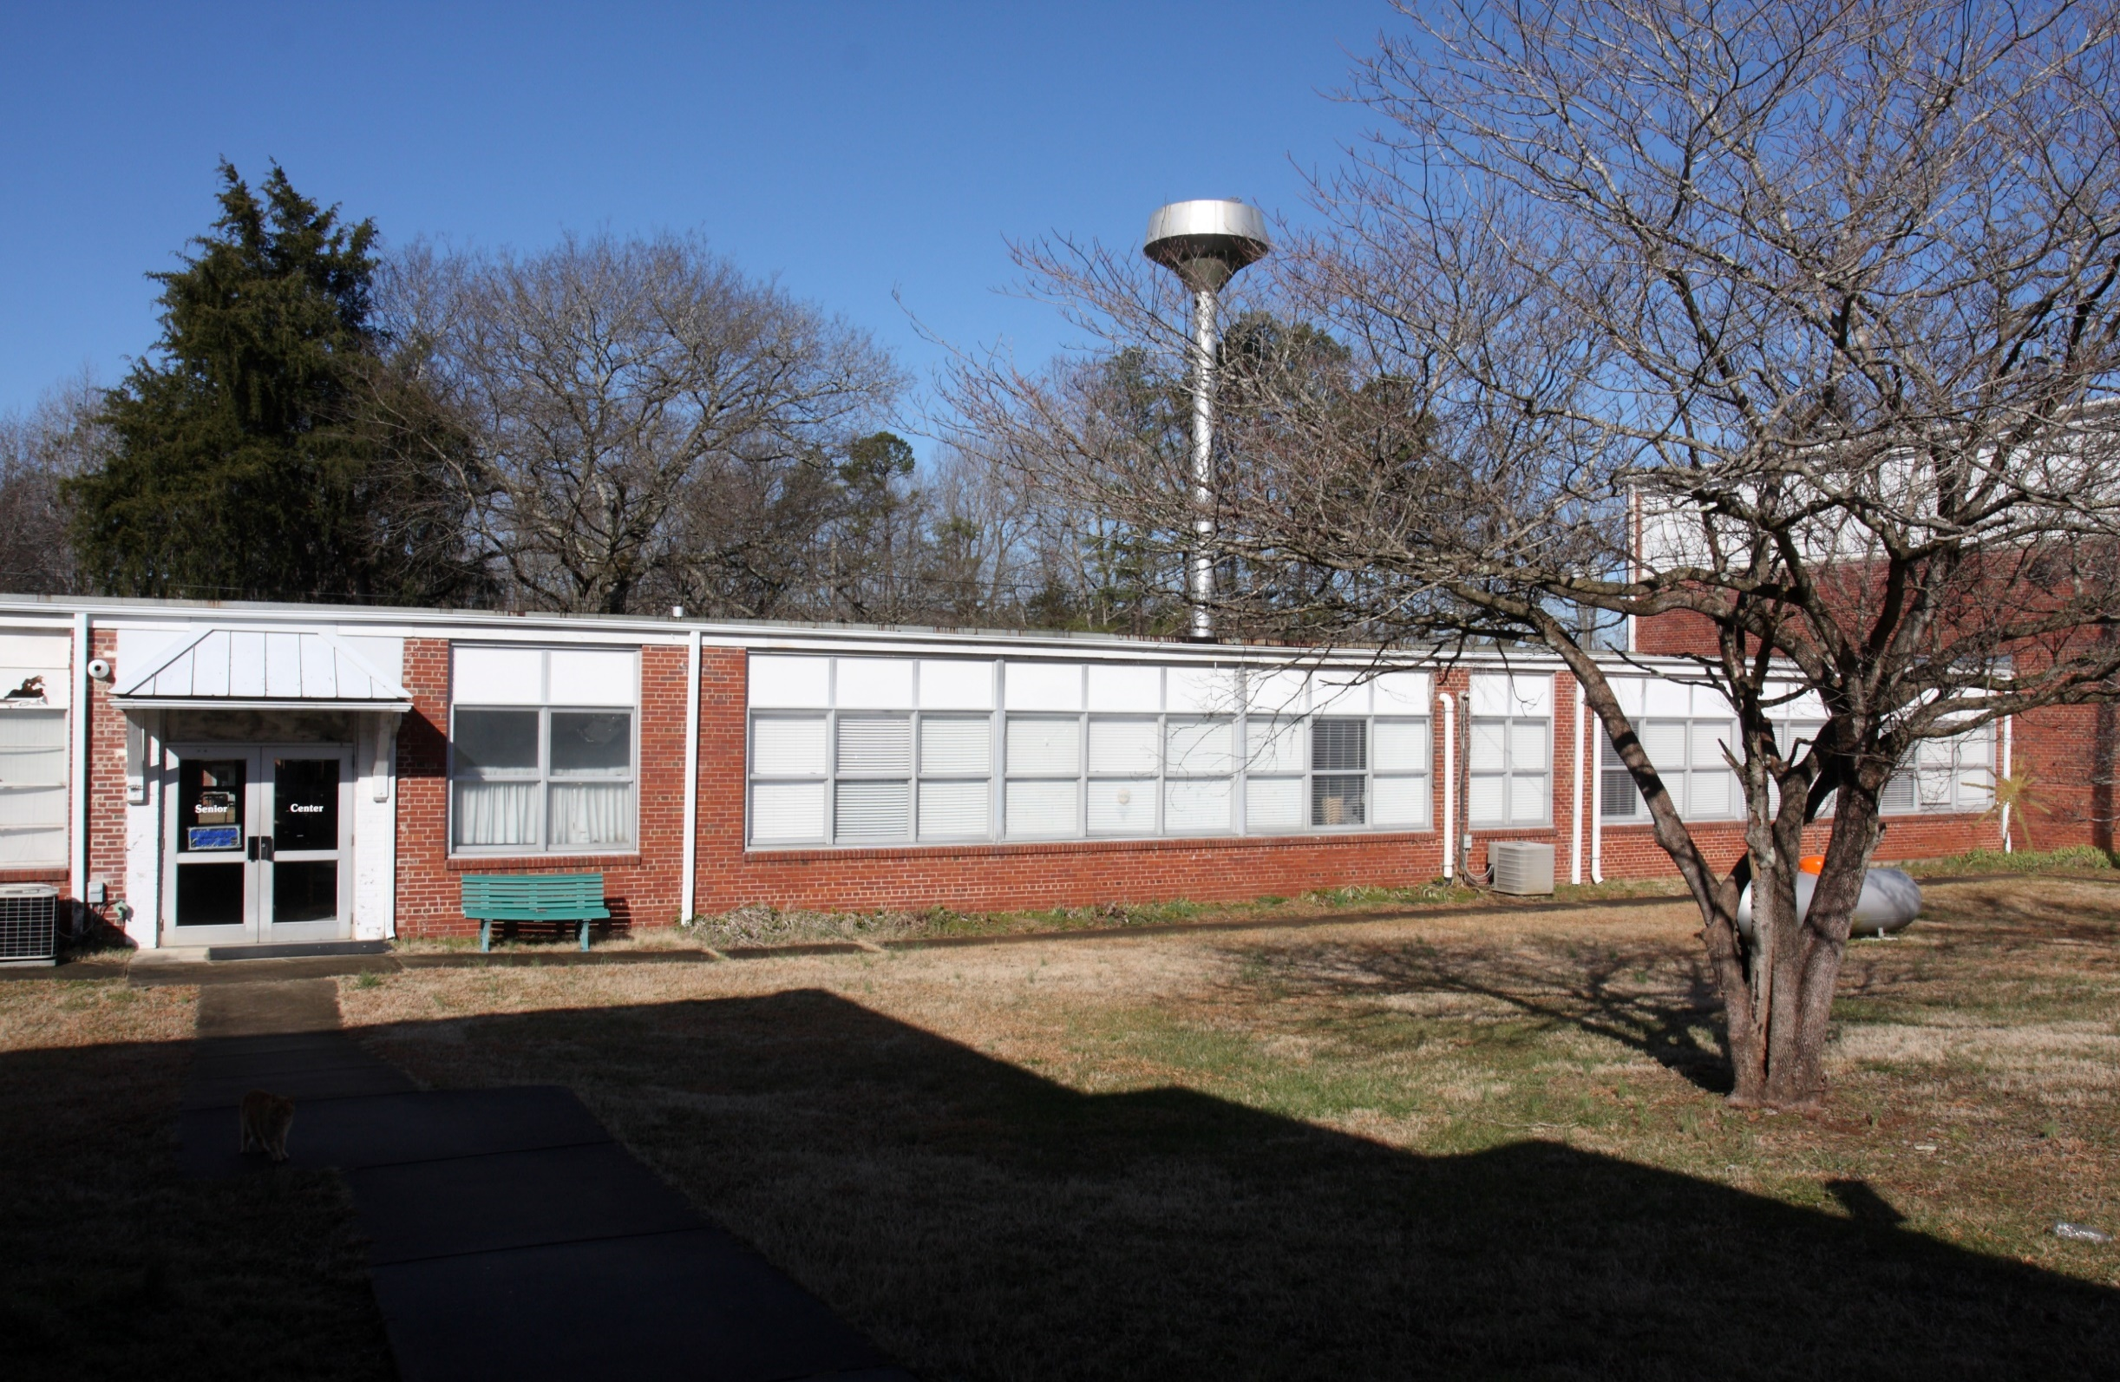
Little River Community Center

Slide 13
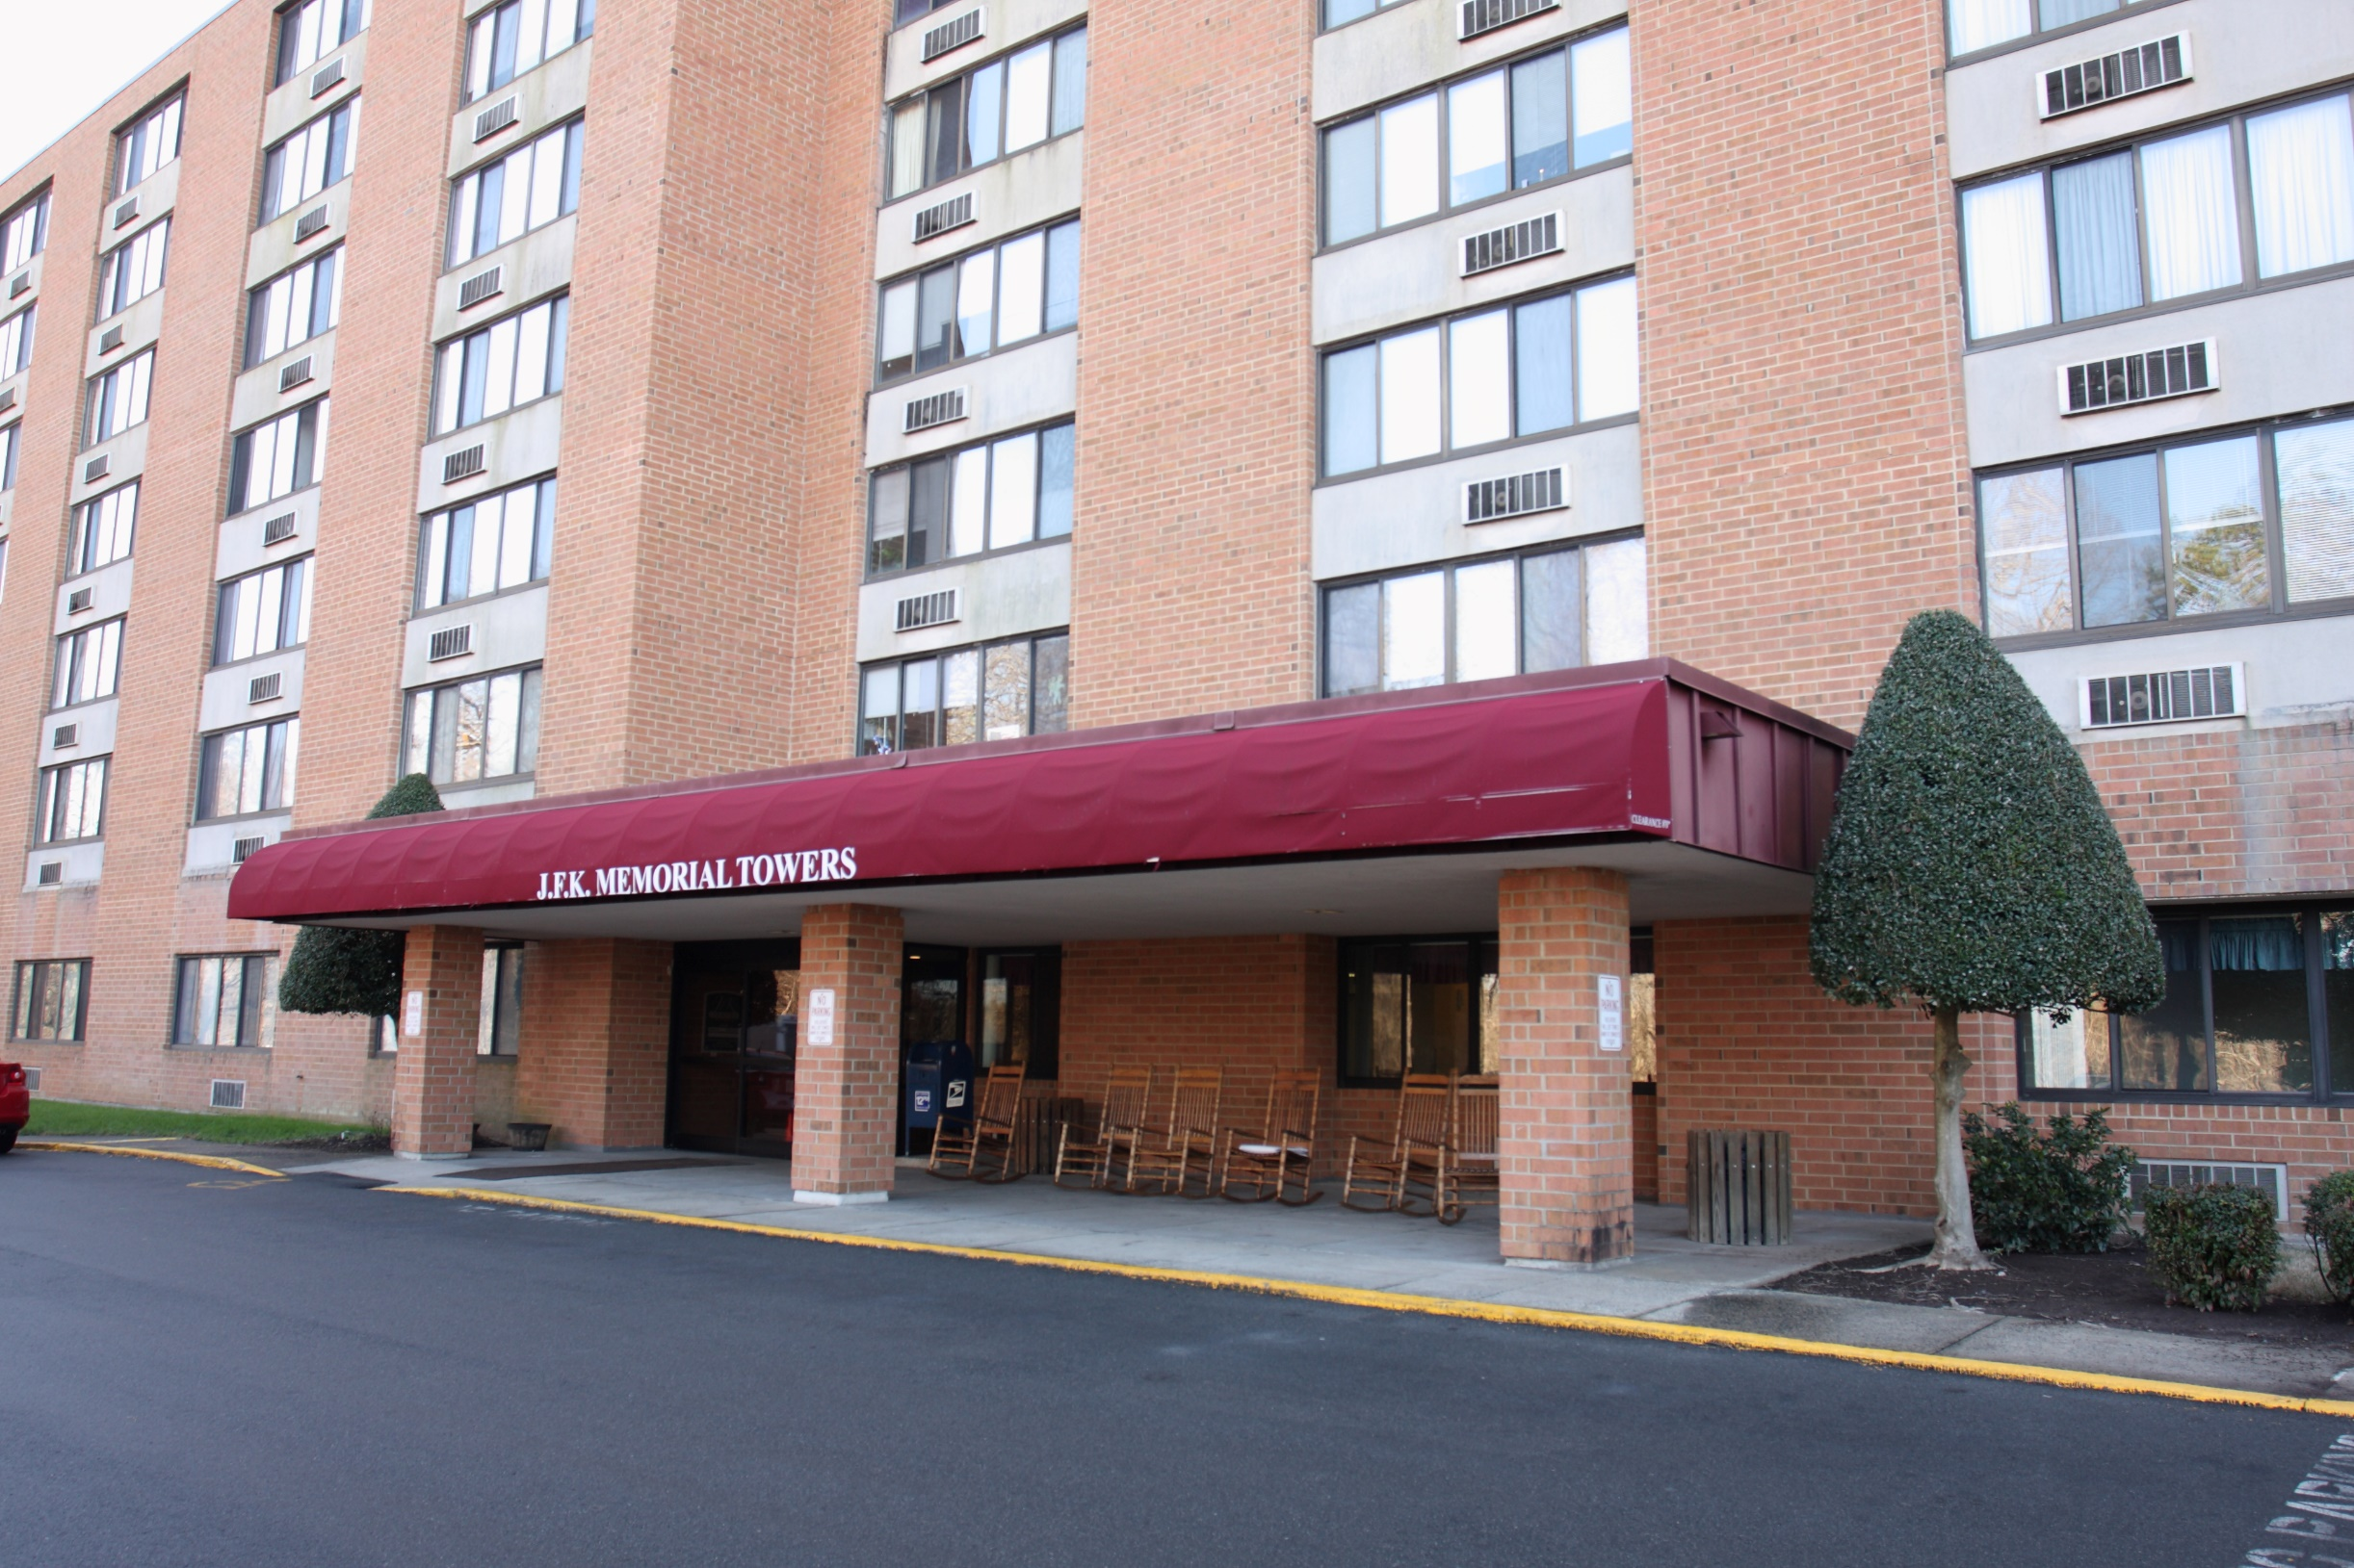
JFK Towers

Slide 14
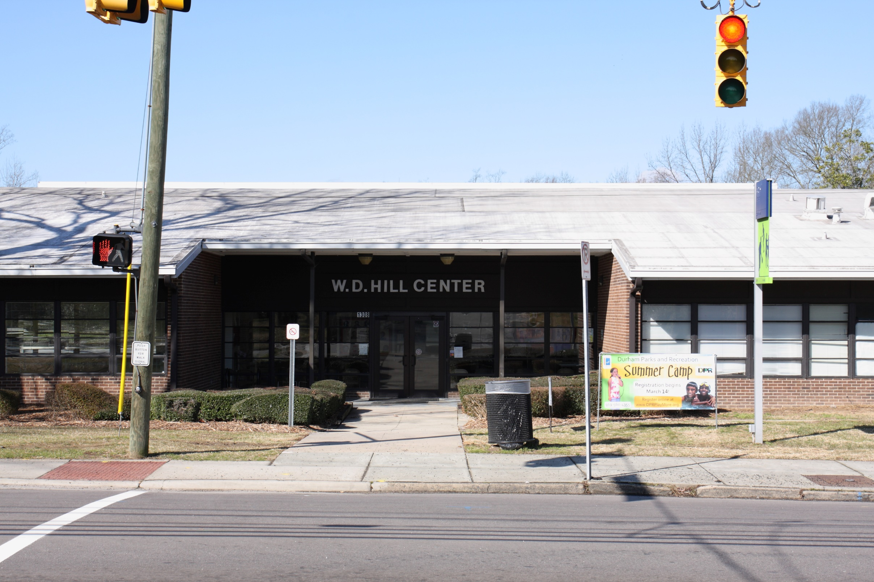
WD Hill

Slide 15
Disease Prevention and Health Promotion at DCSL Centers (Triangle J)
Purpose: Education and implementation of activities supporting healthy lifestyles and promoting healthy behaviors and to reduce need for more costly intervention
Serves those 60 years or older or spouses and/or caregiver of any age
All Title IIID activities must meet the highest-level criteria
Proven effective with older adult population
Fully translated in one or more community sites
Include developed dissemination products available to public
Published in a peer-review journal
Notes:
These classes are evidence based programs developed by researchers at Stanford University to reduce the risk and occurrence of disease and disability among older adults.

Slide 16
Senior Support Services
Assist older adults to maintain independence in home/community throughout Durham County
Information/Assistance (HCCBG, Durham County, Maplewood)
July 2015-February 2016: 2838 participants (ave. 355 monthly)
Food Pantry Fan and A/C Program Telephone Reassurance Program
Legal Aid Turkey/Holiday Drives Housing search assistance
Weatherization application assistance Social Services provided-Maplewood Square Apartments
Onsite social workers from Durham Department of Social Services

Slide 17
Senior Support Services
Options Counseling (HCCBG, Durham County)
Provides individuals over 60 and people with disabilities of any age with information on long-term services and supports in order to live independently in the community, regardless of disability or income.
Also available to caregivers to help determine caregiver support
Current Status: Training and Certification required before implementing program
Family Caregiver Support (Triangle J)
Provides assistance to caregivers of all ages in obtaining information and resources, making long-term care decisions related to caring for older adults.
July 2015-February 2016: 2432 respite hours for average 28 caregivers

Slide 18
Senior Support Services
Transportation:
Congregate Nutrition (HCCBG, Durham County, )
Curb to curb transportation services for residents of Durham County who are 60+ years July 2015-February 2016: 4378 trips for approx. 36 participants
Adult Day Health (EdTap-Elderly and Disabled Transportation Assistance Program)
Curb to curb services for participants July 2015-February 2016: 2440 trips for 11 people
Bus Training (City of Durham)
Travel training to use public transportation provided to seniors
July 2015-February 2016 151 people enrolled ; 36 attending monthly meeting

Slide 19
Adult Day Health/Care (Triangle J, VA, DSS, Private Pay)
Seniors who need supervision during the day
For adults with dementia, cognitive impairment, or physical frailties
Staffing includes Registered Nurse, Certified Nursing Assistants, Social Worker, Activities Director, Program Assistants, Receptionists and Volunteers
Current Status: 55 participants: 9 health/46 care
DSS: 23 (4 H/19 C) VA: 11 C TJ: 13 (3 H/10 C) PP: 8 (2H/6 C)

Slide 20
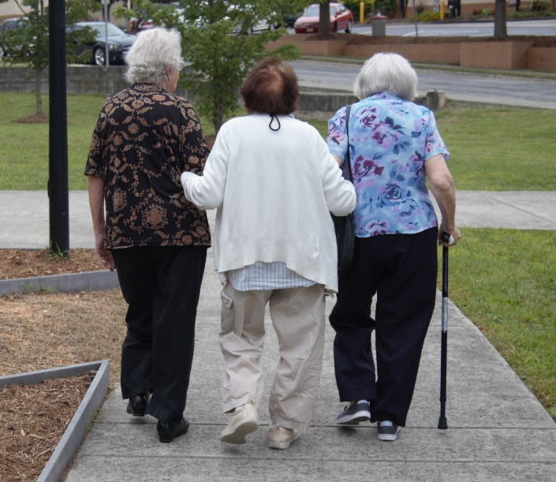

Slide 21
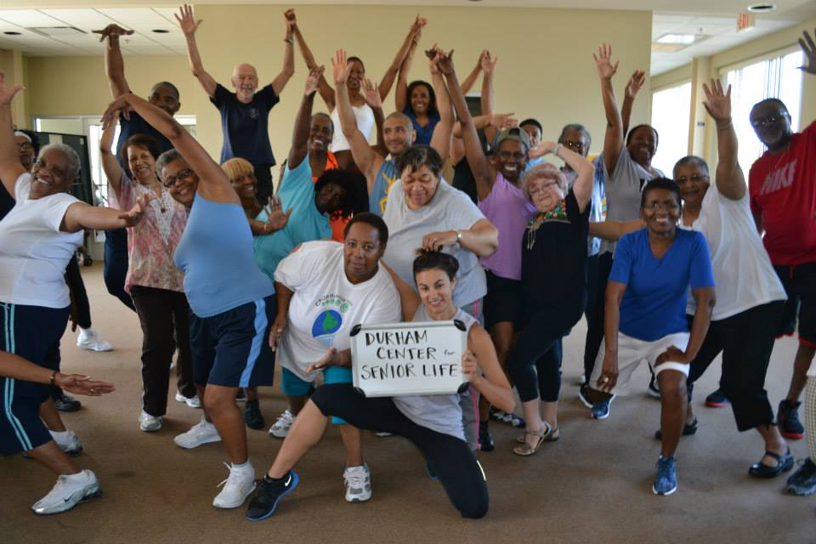
Come join the fun!

Slide 22
The “Graying” of America
By the year 2025, the world’s older population (60 and older) will approach 1.2 billion.
By the year 2030, 1 of every 5 people in the U.S. will be 65 or older.
Older Americans will number more than 65 million

Slide 25
Current and Projected Demographics Durham County 60+
Year | Number | Percentage
2015 | 49,420 | 16.67%
2017 | 53,762 | 17.52%
2020 | 60,021 | 18.61%
2025 | 69,947 | 20.08%
Durham County Residents | 2015 | 2025
0-17 | 23.12% | 22.54%
60+ | 16.67% | 20.08%
Durham County Residents | 2015 | 2025 | % change
0-59 | 247,072 | 278,375 | +13%
60+ | 49,420 | 69,947 | +42%
Source: North Carolina Office of State Budget and Management, Population Estimates and Projections, 2014

Slide 26
Durham Center for Senior Life thanks Durham County Cares!
www.dcslnc.org
406 Rigsbee
919-688-8247

