Slide 1
2015 Durham County Cares Campaign
Recipient Organization Presentations
Thursday, September 17, 2015

Slide 2
2015 Durham County Cares Recipient Organizations
Community & Family Prosperity
Durham Rescue Mission
John Avery Boys & Girls Club
Health & Well-Being for All
Exchange Family Center/Exchange Clubs' Child Abuse Prevention Center
Senior PharmAssist, Inc.
Safe & Secure Community
Salvation Army Boys & Girls Club of Durham
Durham Crisis Response Center
Environmental Stewardship
Environmental Federation of North Carolina DBA: EarthShare North Carolina
Toxic Free NC
Miscellaneous/Multiple Area Services
Durham Center for Senior Life
United Way of the Greater Triangle

Slide 3
Durham Center for Senior Life

Slide 4
Durham Center for Senior Life
406 Rigsbee Avenue Suite 202 Durham, NC 27701
(919) 688-8247
www.dcslnc.org

Slide 5
History
Founded in 1949: Golden Age Society, providing neighborhood clubs
Received first Older Americans Act grant,1966
changed name,1968: Council for Senior Citizens
‘Home’ provided 2006, became Durham Center for Senior Life (DCSL) 2010
Private non-profit organization, designated by the State of North Carolina
as a Center of Excellence.
4 senior centers:
*Downtown (main center) *W.D. Hill Parks and Recreation Center
*JFK Towers *Little River Community Center
Offer a wide array of programs and services for older adults: congregate meals, transportation, adult education, exercise classes, socialization, health promotion, caregiver support services and information and options counseling, adult daycare

Slide 6
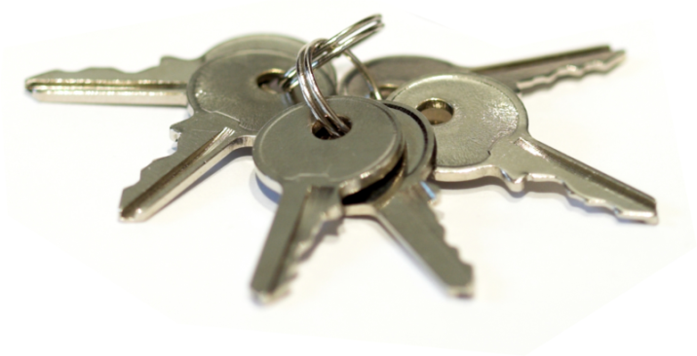
KEY BELIEFS
Older adults are a growing valuable community resource and will be appreciated and respected.
Older adults are entitled to quality services to maintain a healthy and active life. Older adults contribute a wealth of knowledge and skills; we will engage them to share their wisdom and experience.
The Durham Center for Senior Life believes in treating everyone fairly, respectfully and with the highest ethical standards.

Slide 7
MISSION STATEMENT
"Enhancing the lives of older adults through education, recreation, nutrition and social services in welcoming community settings."
Notes:
We have 400 people pass through our Senior Center on Rigsbee every week for activities and receive 4,200 contacts for information and referral to find solutions for problems they face at the right time.

Slide 8
Current and Projected Demographics Durham County 60+ North Carolina Office of State Budget and Management: Population Estimates and Projections 2014
Source: North Carolina Office of State Budget and Management, Population Estimates and Projections, 2014

Slide 9
Cost-Effectiveness of Aging in Place in Raleigh-Durham
Institutional Care | Avg. Monthly Cost
Private Room in a Skilled Nursing Facility | $7,560
Semi-Private Room in a Skilled Nursing Facility | $6,150
Assisted Living Facility | $3,544
Aging in Place Care | Avg. Monthly Cost
In Home Aide ($19/ hour at 10 hours/week) | $760
Home-Delivered Meals (Meals on Wheels of Durham) | $110
Adult Day Health ($40 at 22 days) | $880
Senior PharmAssist (Direct Financial Assistance for Medications, Medication Management, Tailored Community Referral, & Medicare Insurance Counseling) | $73
Total | $1,823
Source: MetLife Market Survey of Nursing Home, Assisted Living, Adult Day Services, and Home Care Costs, 2013

Slide 10
Statistics: Durham Center for Senior Life, July 2015
Senior Center/satellite centers:
800+ participants in fitness/exercise classes/entertainment/arts/education/social events
Congregate meal sites (JFK Towers, WD Hill Parks and Recreation Center, Little River Community Center in Bahama):
Served 1,960+ hot meals to 120+ seniors
Family Caregiver Respite Program:
Served over 30 caregivers 10-13 hours each monthly of respite (plus monthly support group)

Slide 11
Statistics, Durham Center for Senior Life, July 2015
Information and Assistance:
Served 500+ seniors needing referrals/resources (housing, utilities, clothing, food, medical, weatherization, legal, etc)
Options Counseling:
Providing support to seniors and families who are going through a transitional phase of life: retirement, new diagnosis, change in ability to care for self, looking at relocating, etc.
Adult Day Health: (provides daycare for up to 60 participants)
Currently serving 46; providing recreation/social stimulation; education/intellectual stimulation; health promotion/wellness; culture/creativity; music therapy
Transportation:
Provided 722 trips to 36 seniors to and from our congregate meal sites
Provided transportation to/from facility for 10 seniors in Adult Day Health program
Provided transportation to 18 seniors over 65 years of age to/from employment
Provided bus training to over 25 seniors wanting to utilize public transportation

Slide 12
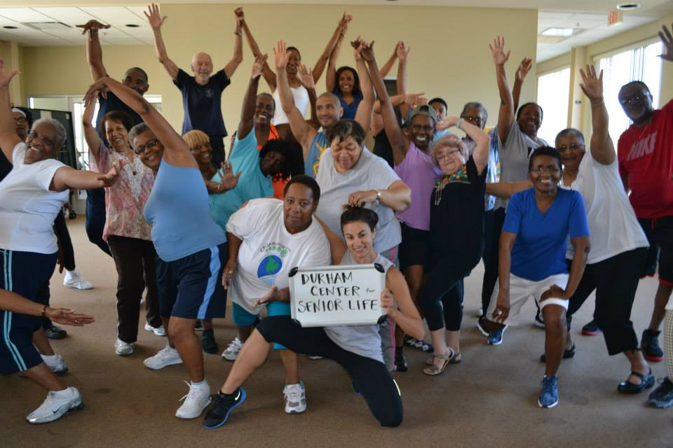
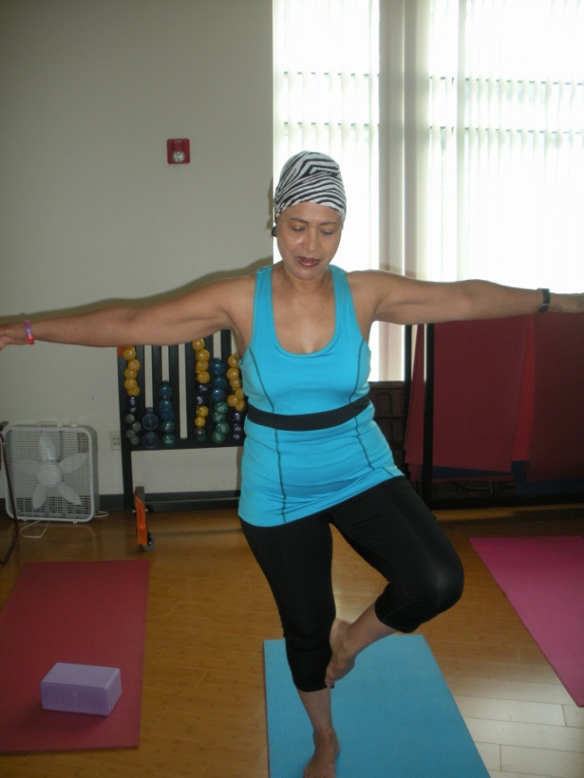
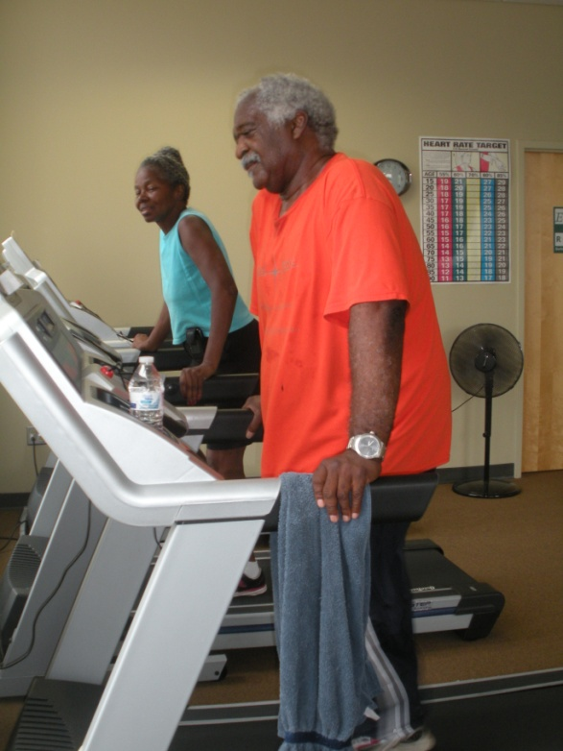
Senior Center Activities

Slide 13
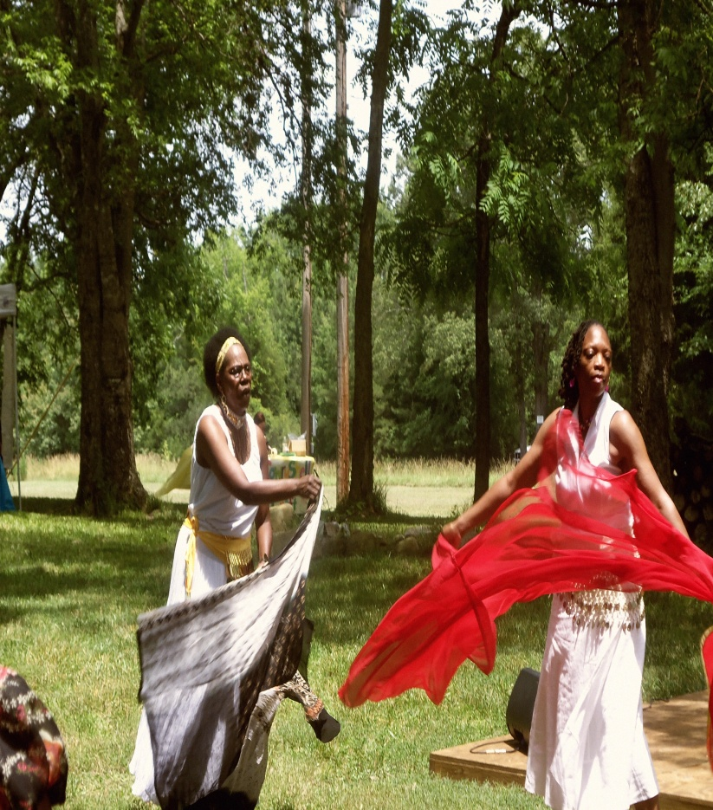
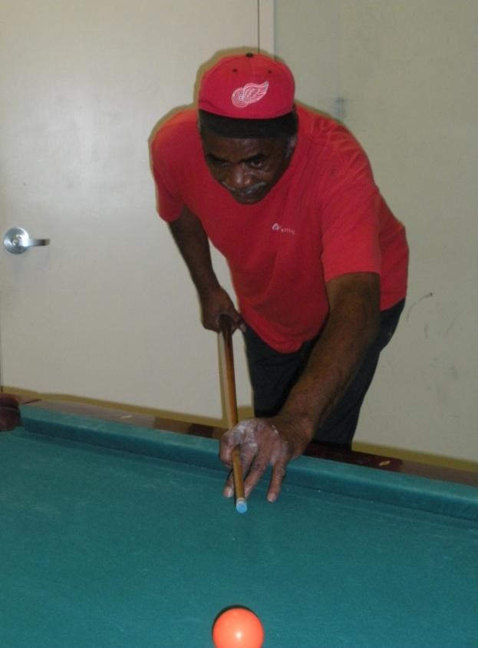
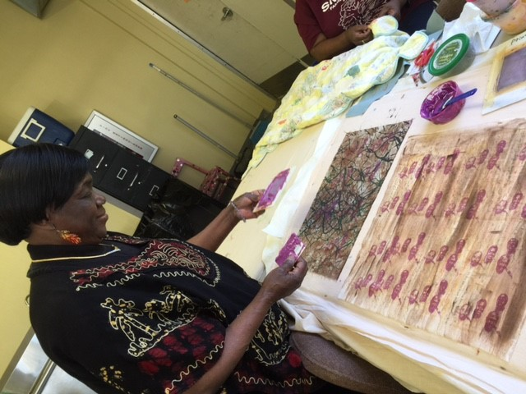
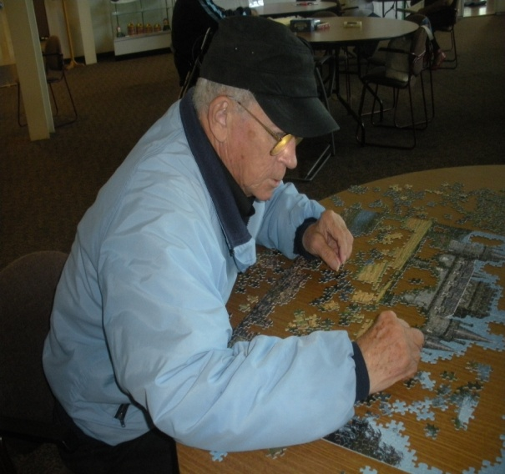

Slide 14
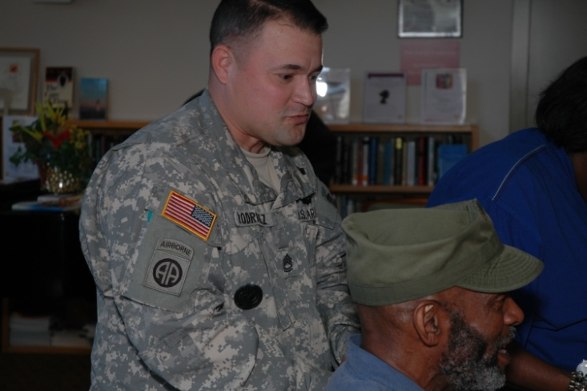
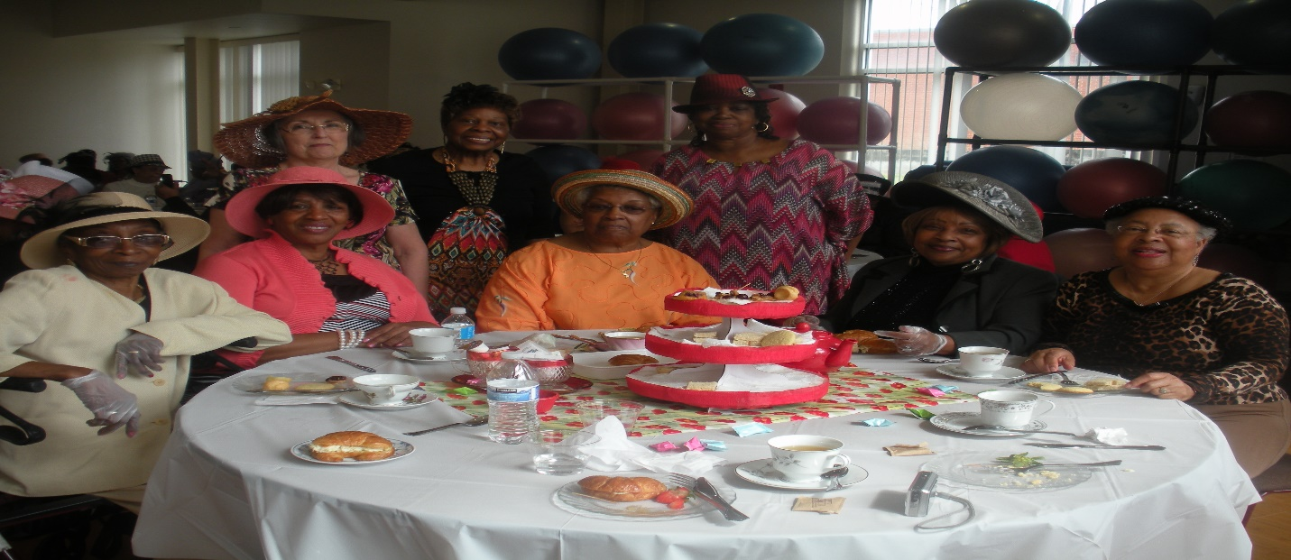
Senior Center Special Events

Slide 15
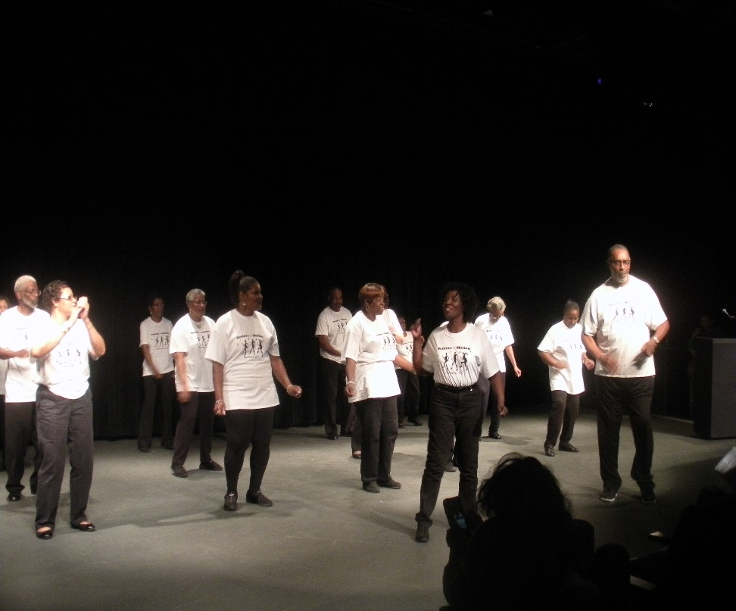
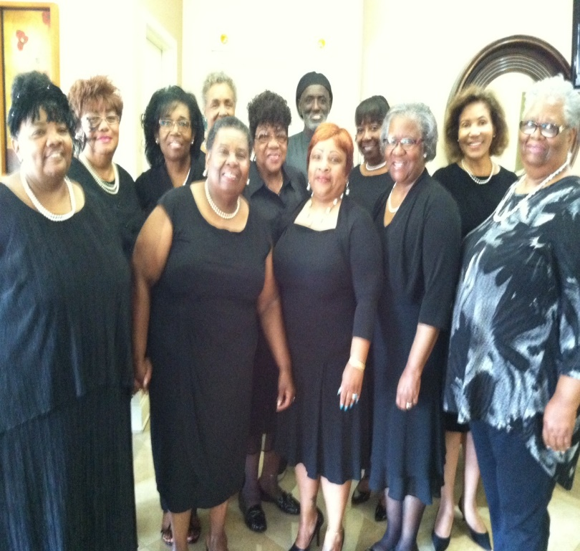
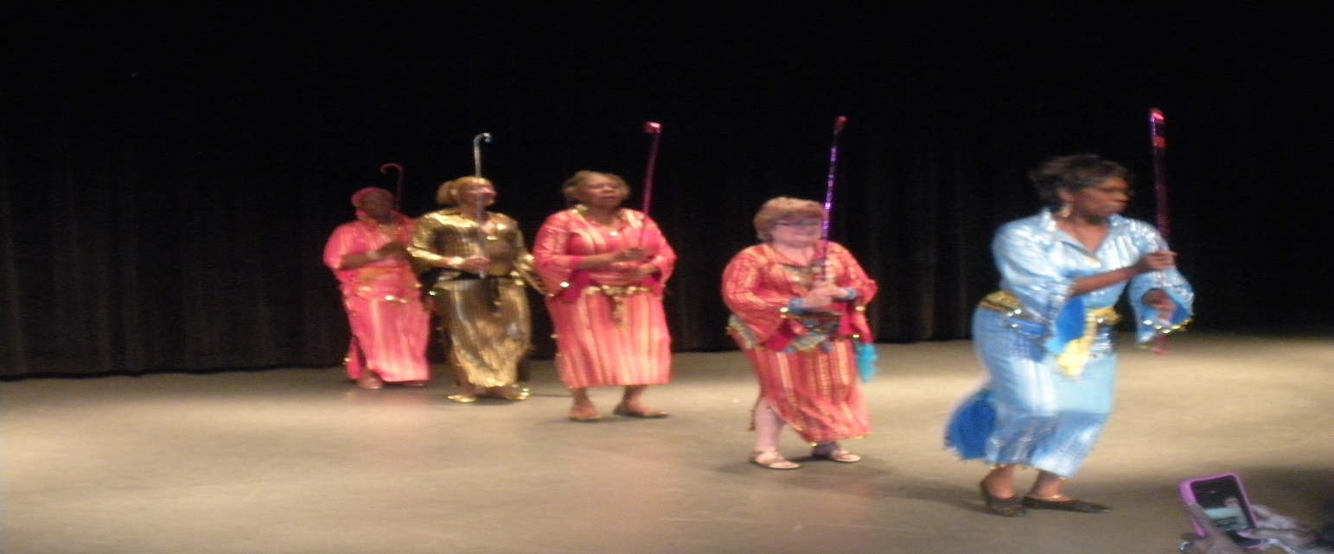

Slide 16
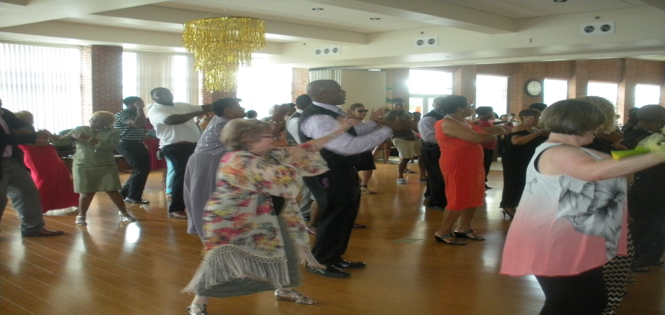
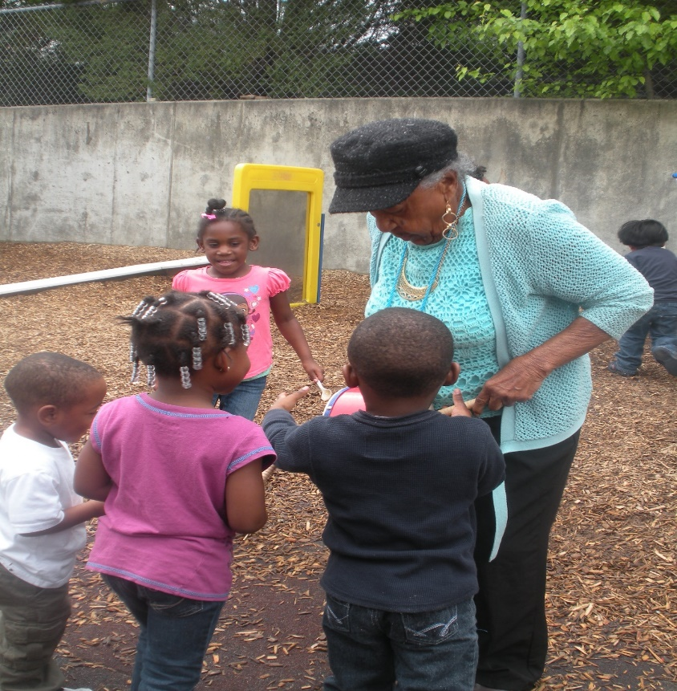
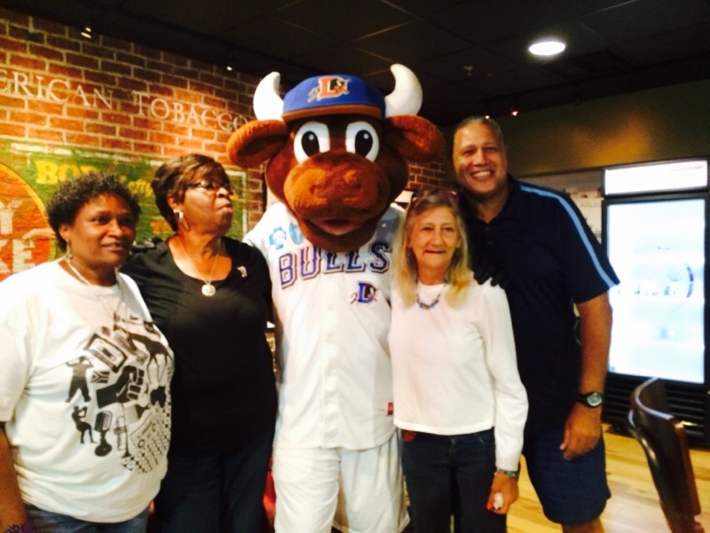
Special Events
Notes:
Here are some pictures from our annual Halloween Party.

Slide 17
Health Promotion Managing Chronic Health Problems
Walk With Ease
Matter of Balance
Fit For Life
Chronic Disease Self Management
Otago
Geri Fit
Taking Off Pounds Sensibly
Notes:
These classes are evidence based programs developed by researchers at Stanford University to reduce the risk and occurrence of disease and disability among older adults.

Slide 18
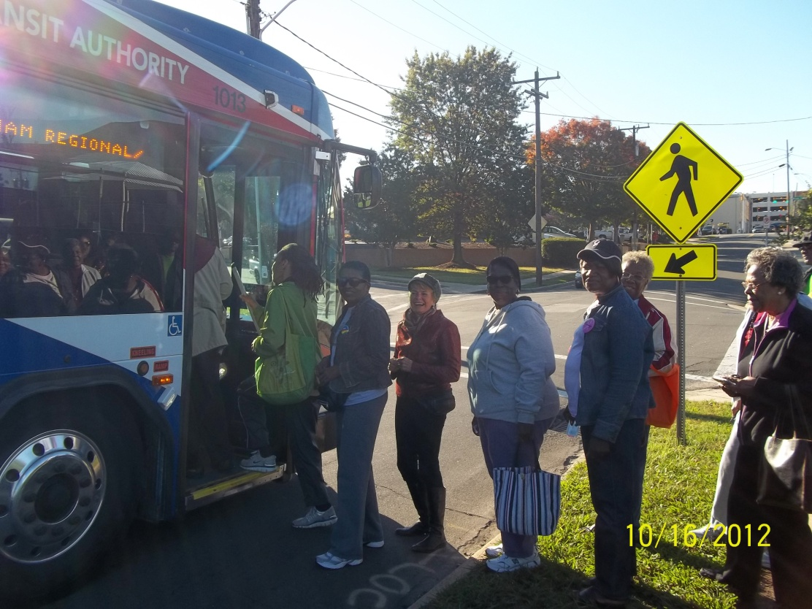
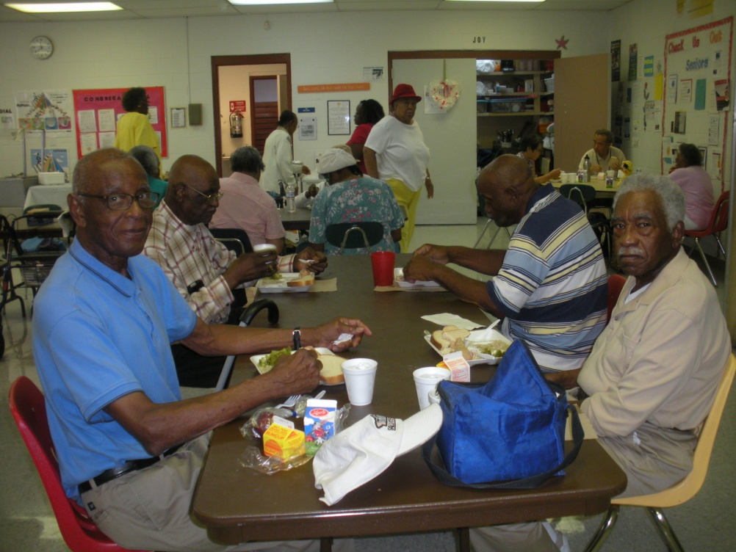
Travel Training, Job Access Reverse Commute, and
Transportation services are provided to seniors and disabled citizens to and from DCSL facilities
.

Slide 19
Congregate Nutrition
Satellite centers provide nutritional meals:
JFK Towers, located in a senior housing community
W.D. Hill Center, located in a Durham Parks and Recreation facility
Little River Community Center, located in a rural site in Bahama

Slide 20
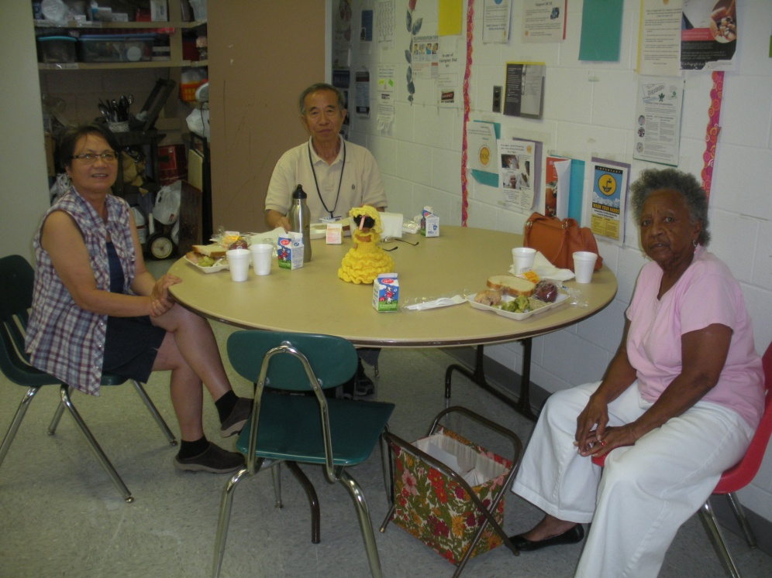

Slide 21
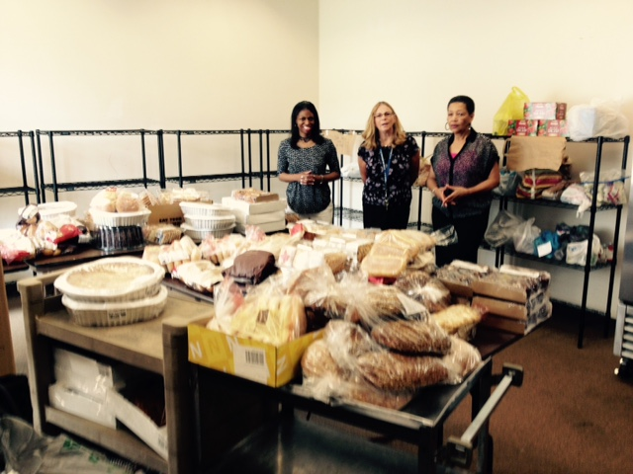
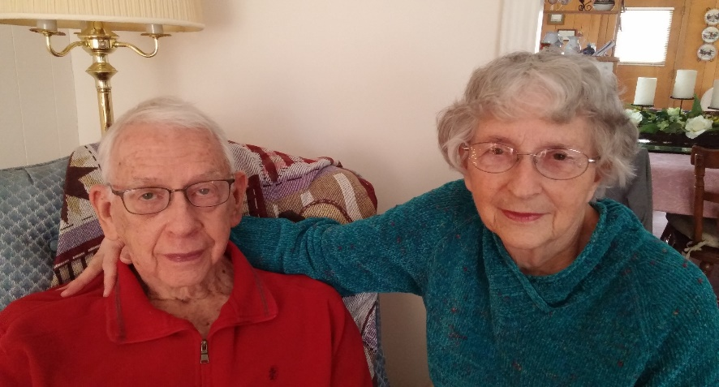
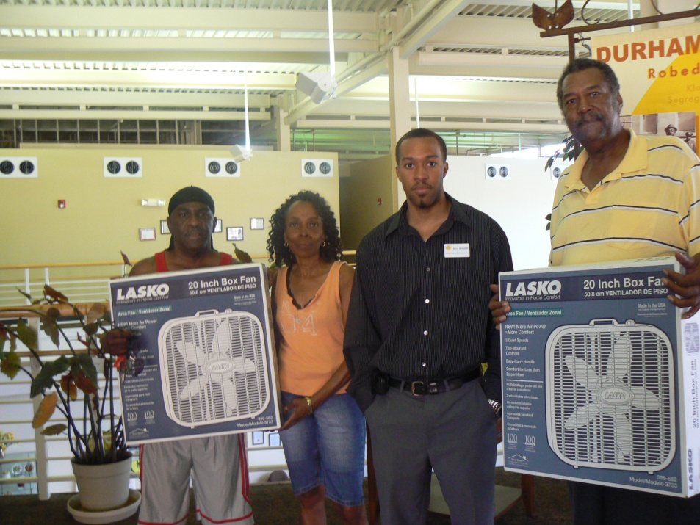
Senior Support Services
Information and Options Counseling
Transportation
Family Caregiver Respite
Fans, food pantry, legal aide, utilities,
Housing, weatherization, taxes
Notes:
We partner with an agency called Inter-Faith Food Shuttle to provide grocery bags of weekend meals for our congregate meal recipients and have provided 594 meals.

Slide 22
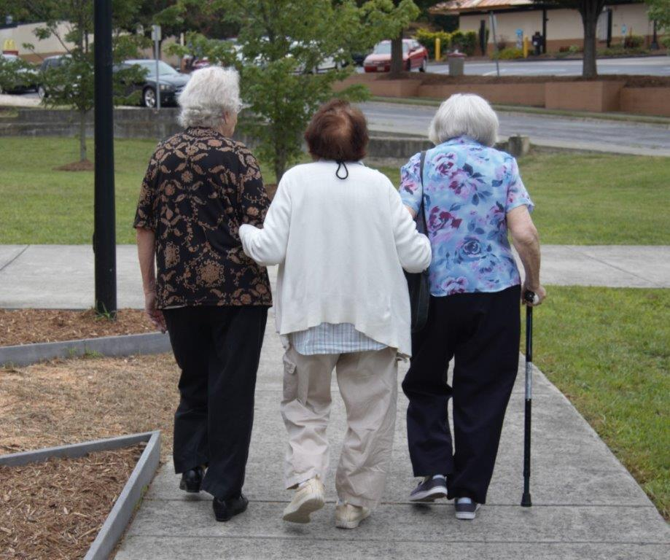
Adult Day Health Center For adults who need supervised care throughout the day
*Full-time supervision *Medical supervision/monitoring
*Personalized care/attention *USDA approved meals/snacks
*Assistance with care/mobility *Geriatric exercise, fellowship

Slide 23
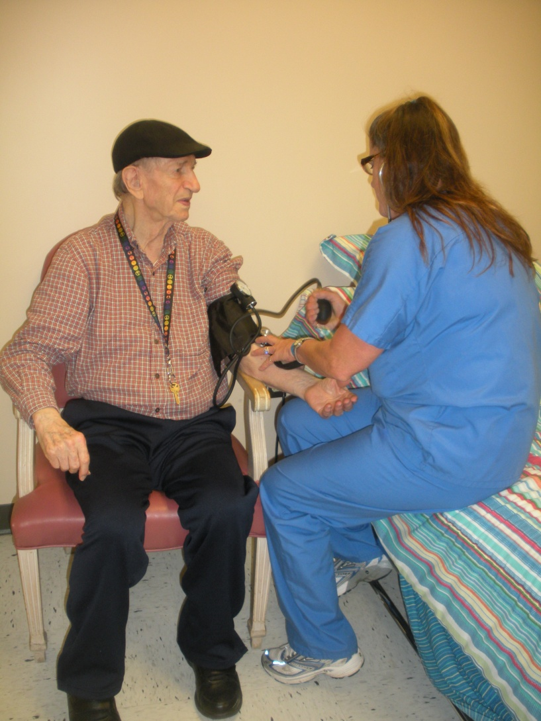
Adult Day Care and Respite Care
*Music in My Mind *Arts and Crafts *Bingo *Singing
*Cognitive Games *Karaoke *Sports *Movies
*Rest and Relaxation *Theater Arts *Nature Programs
*Gardening *Reading *Reminiscing *Dancing
*Chair Yoga *Intergenerational programs

Slide 24
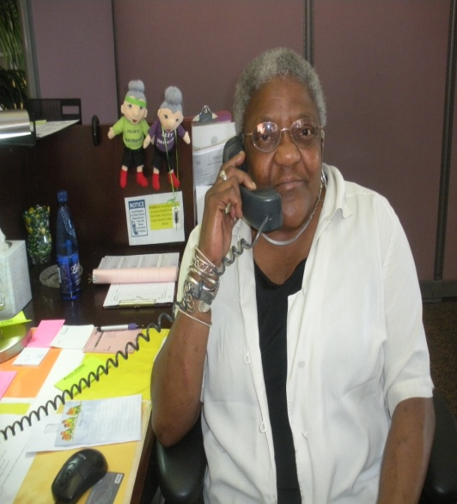
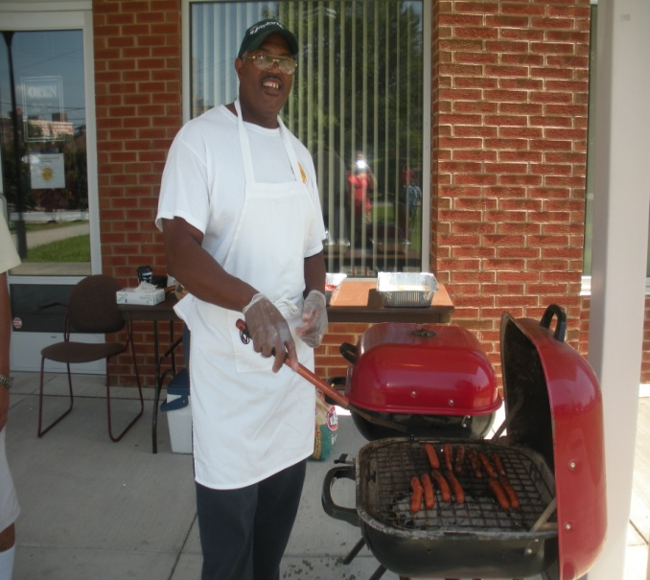
Volunteers
Contribute 400+ hours weekly

Slide 25
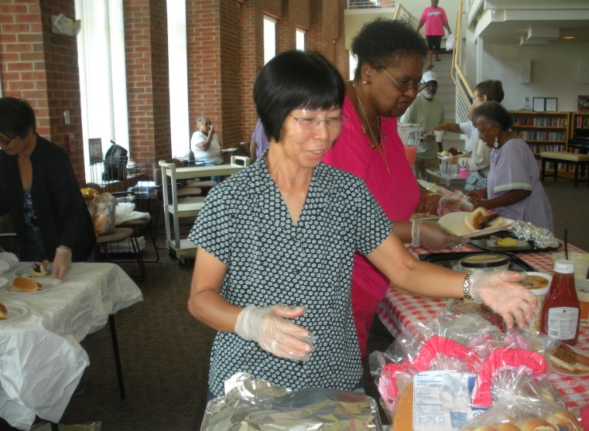
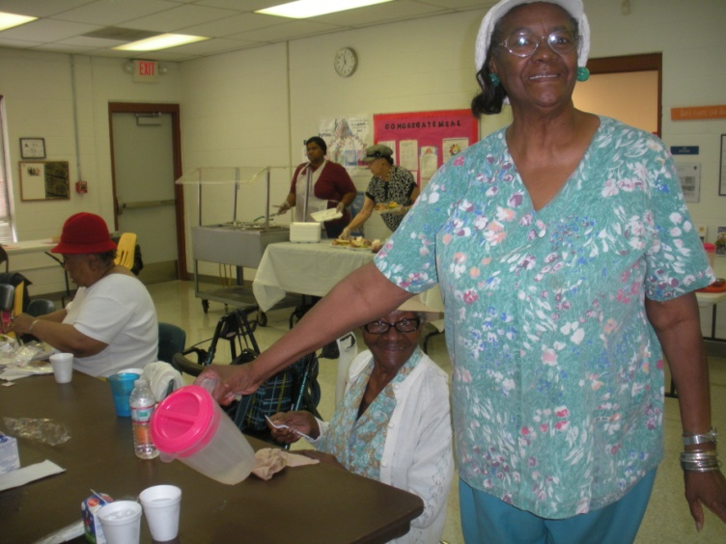
VOLUNTEERS

Slide 26
Community Partnerships
Food Bank of Central & Eastern NC
RSVP
Durham County Cares
Duke University
Legal Aid of NC
Triangle J Area Agency on Aging
Durham Partnerships for Seniors
Durham Parks and Recreation
City of Durham Police Department
UNC-Chapel Hill
Triangle Community Foundation
Community Resource Connections
Durham County
Ninth Street Bakery
NCCU
Rotary of Durham
Durham Merchants
Association
Head
Start
Notes:
We couldn’t do all the work without community partners.

Slide 27
Durham Center for Senior Life
406 Rigsbee Avenue
Durham, NC 27712
919-688-8247
www.dcslnc.org

Slide 28
CONTACT US:
Cathy Stallcup, Executive Director
cstallcup@dcslnc.org
(919) 688-8247 X 106

Slide 29
CLICK HERE
TO DONATE NOW

