Slide 1
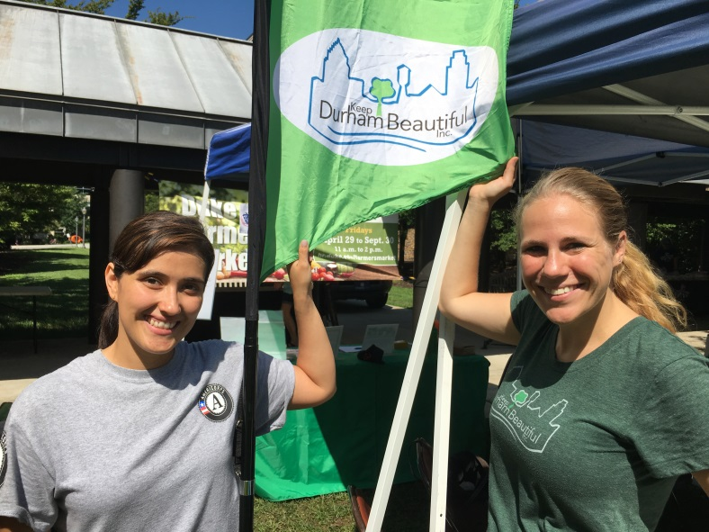
Keep Durham Beautiful
Empowering volunteers to create a cleaner, greener Durham
Tania Dautlick, Executive Director
Erin Victor, Sustainability Specialist
Monica Ospina, AmeriCorps Member
Engaging & inspiring individuals to take greater responsibility for their community environment

Slide 2
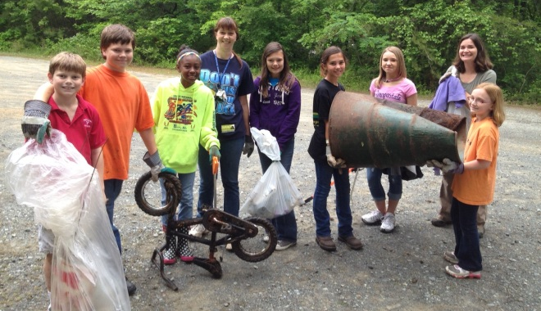
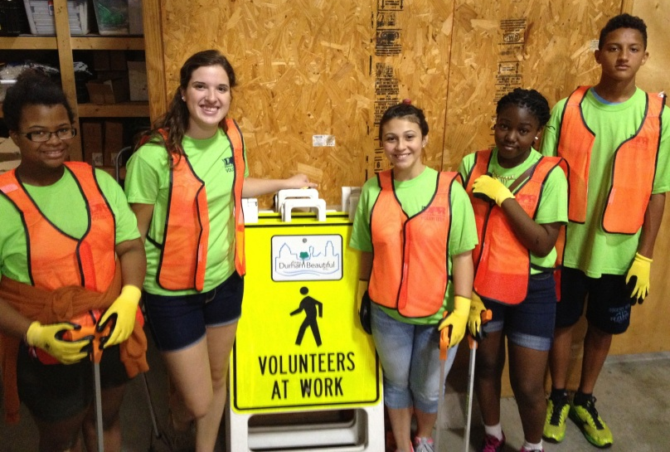
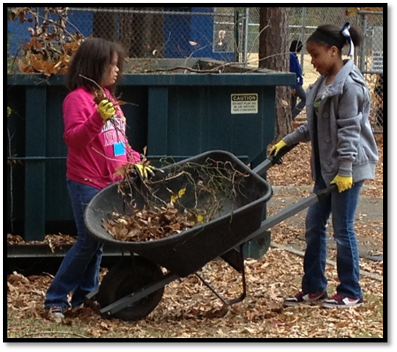
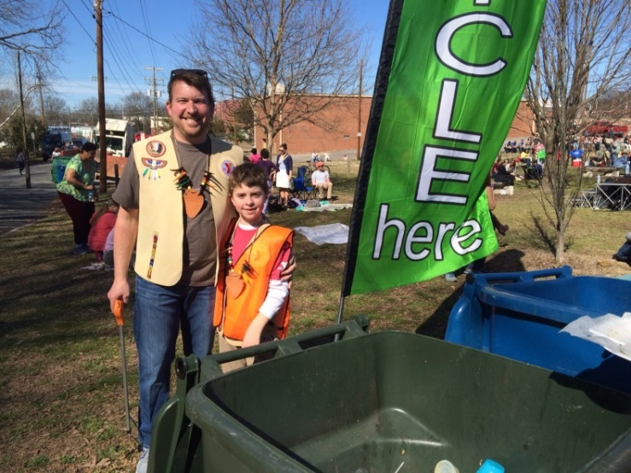
It’s All About the Volunteers
Engaging & inspiring individuals to take greater responsibility for their community environment

Slide 3
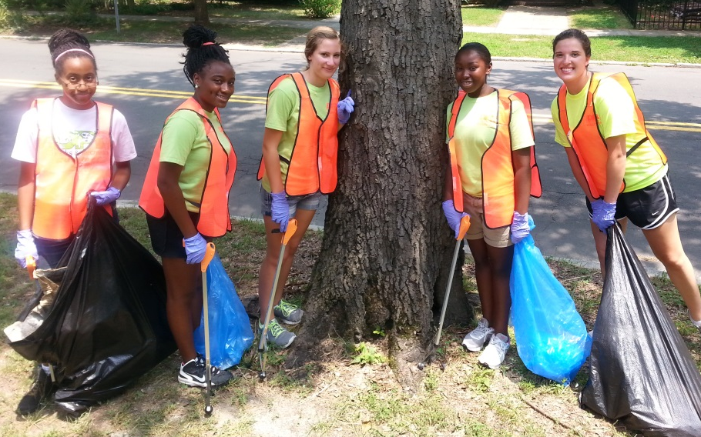
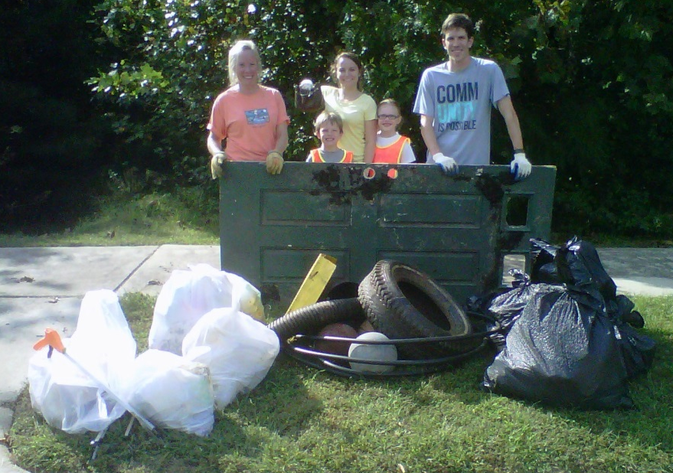
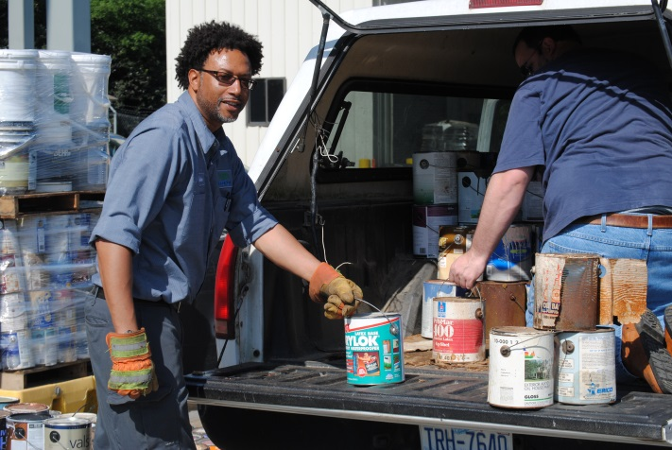
Litter Prevention: Big Sweep is Saturday!
Durham County-wide annual cleanups:
October: Big Sweep
March: Creek Week
June: Clean Your Block & Tire Recycling
Engaging & inspiring individuals to take greater responsibility for their community environment

Slide 4
Mission | Focus
Mission
To engage and inspire individuals to take greater responsibility for their community environment
Focus Areas
Litter Prevention
Waste Reduction and Recycling
Beautification and Community Greening
Engaging & inspiring individuals to take greater responsibility for their community environment

Slide 5
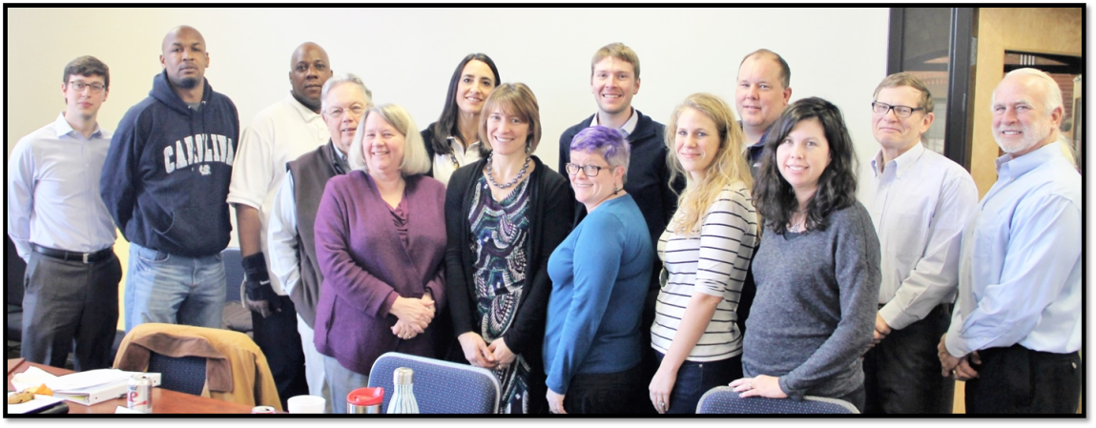
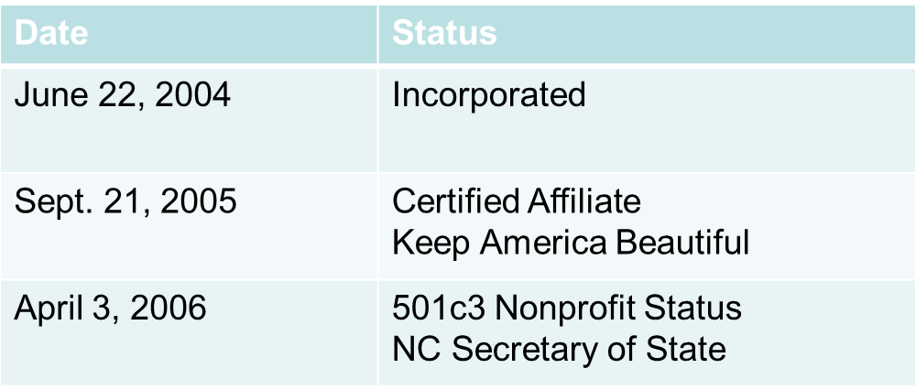
KDB Founding & Affiliation
Engaging & inspiring individuals to take greater responsibility for their community environment

Slide 6
FY2015-16 Highlights -Volunteer Results
In FY2015-16 Keep Durham Beautiful has…
Engaged 3,230 Volunteers at 183 Events & educated 1,481 youth
Volunteers contributed 10,580 hours &
made 99 public spaces cleaner & greener
Valued at $23.07/hour,
Volunteers donated $244,081
worth of their time to make Durham a more beautiful place to work, live, & play!

Slide 7
FY 2015-16 Highlights -Volunteer Results
Over 1,035 trees planted &
1,701 tree seedlings & bulbs handed out
13,576 lbs recyclables and compostables diverted from the landfill
105,675 lbs litter picked up from Durham parks, streams, bus stops & roads

Slide 8
Keep Durham Beautiful engages Volunteers who take action in Durham communities to transform public spaces into Beautiful places through:
Litter Prevention
Recycling and Waste Reduction
Community Greening

Slide 9
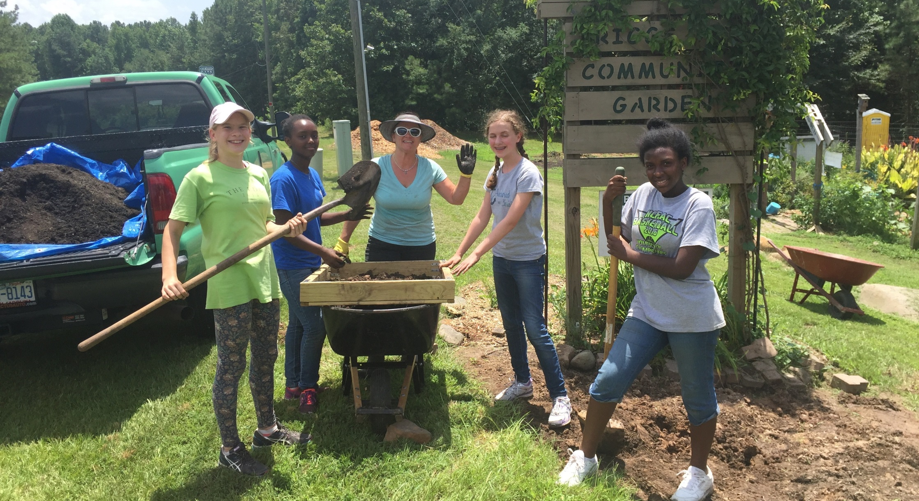
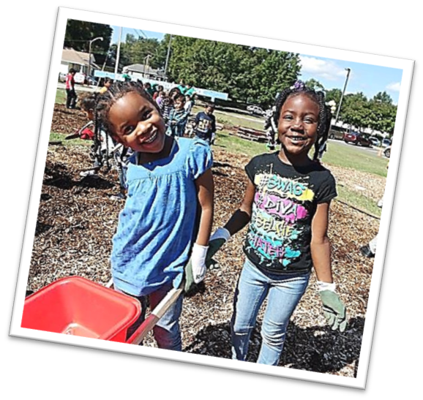
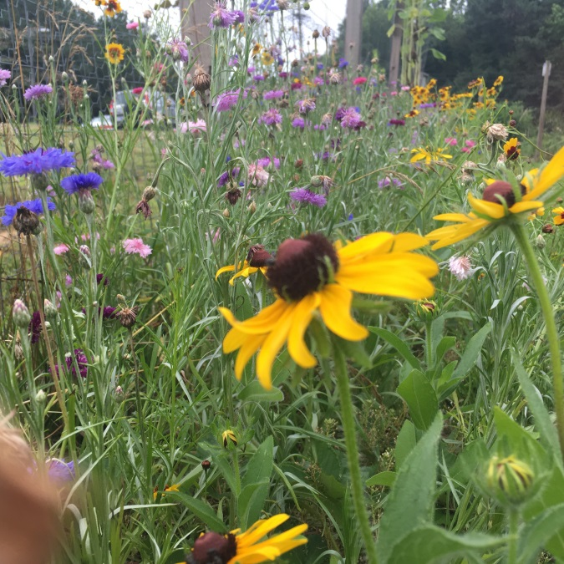
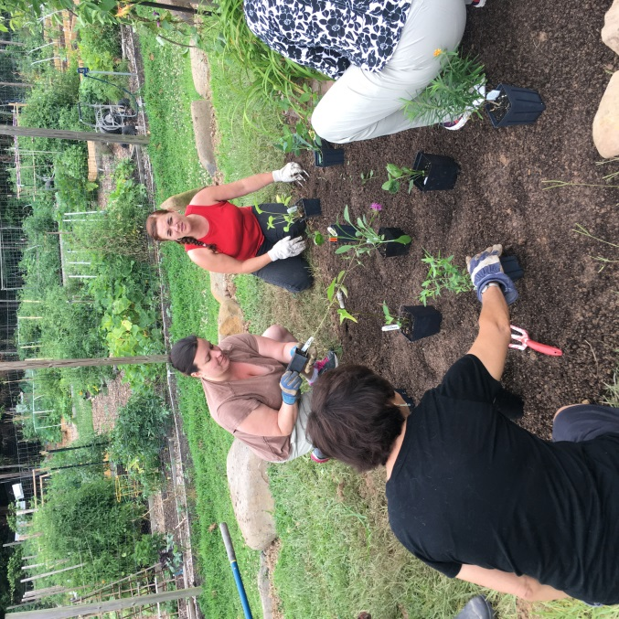
Greening: Pollinator Gardens: Briggs Avenue Garden

Slide 10
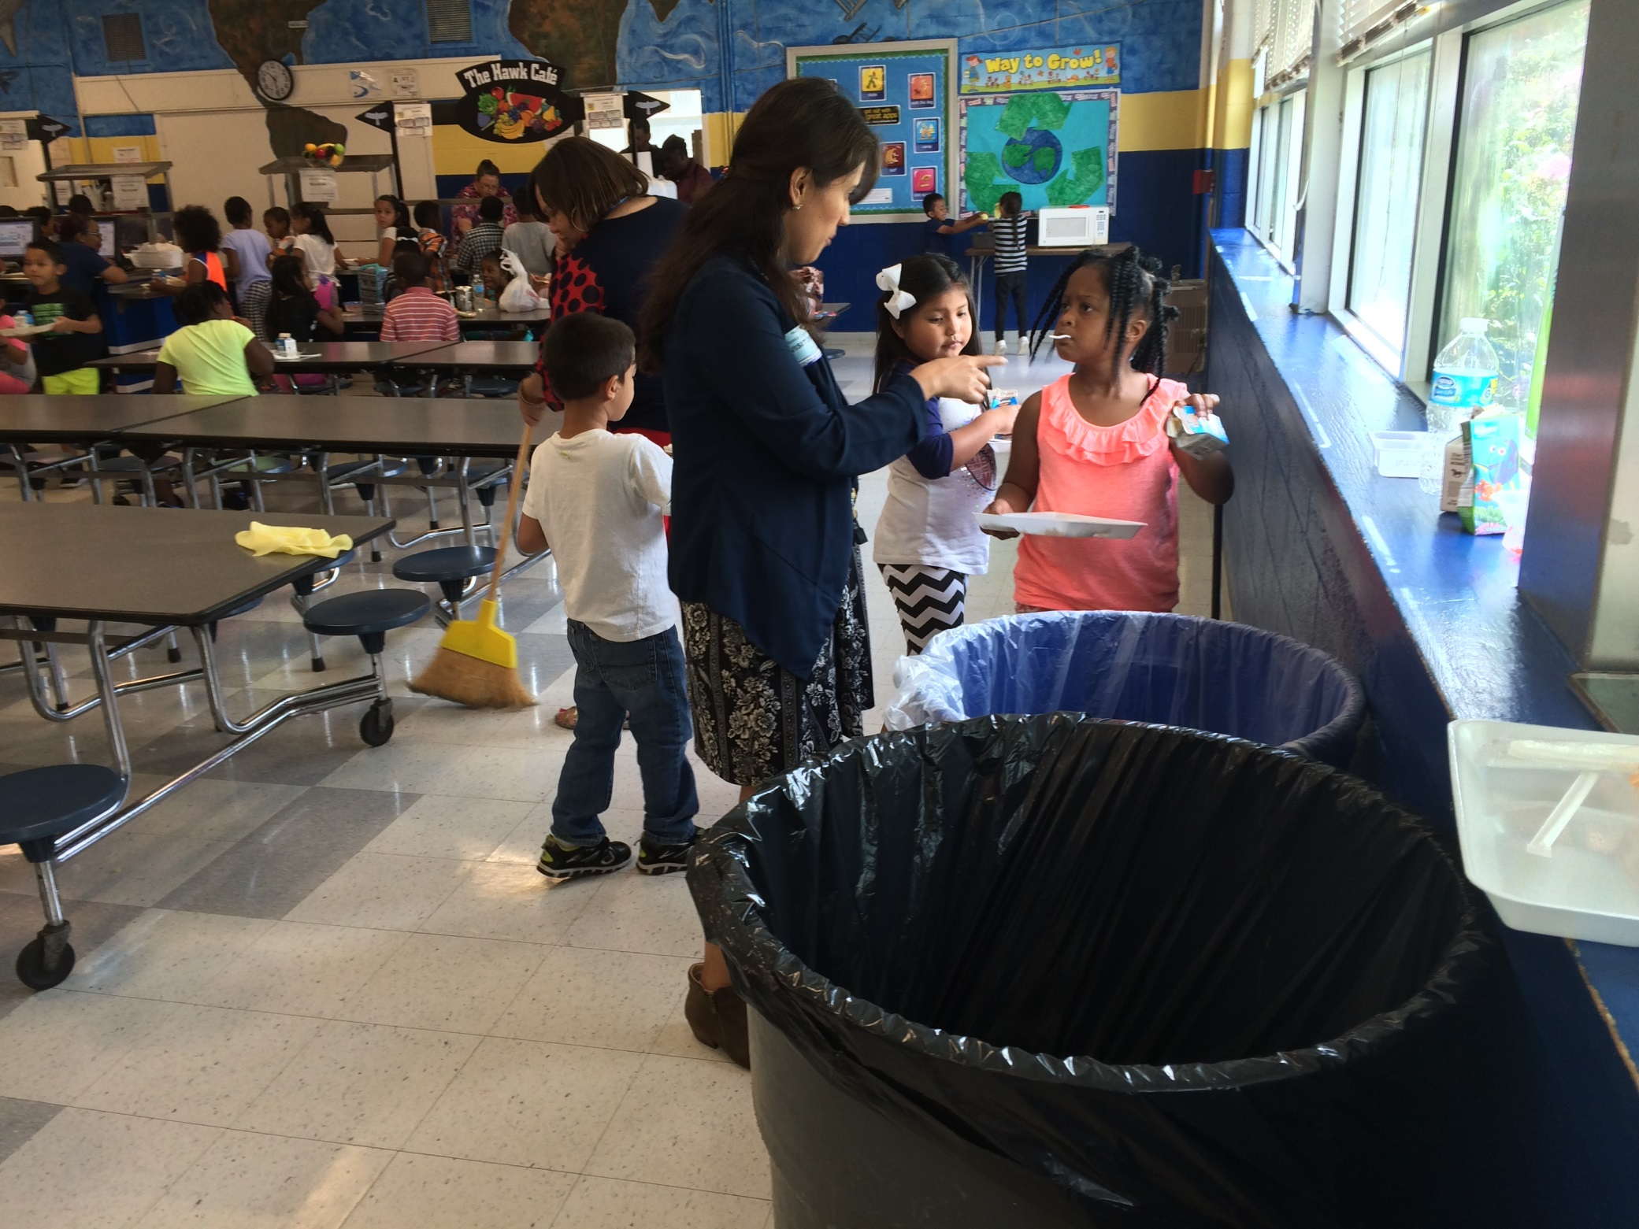
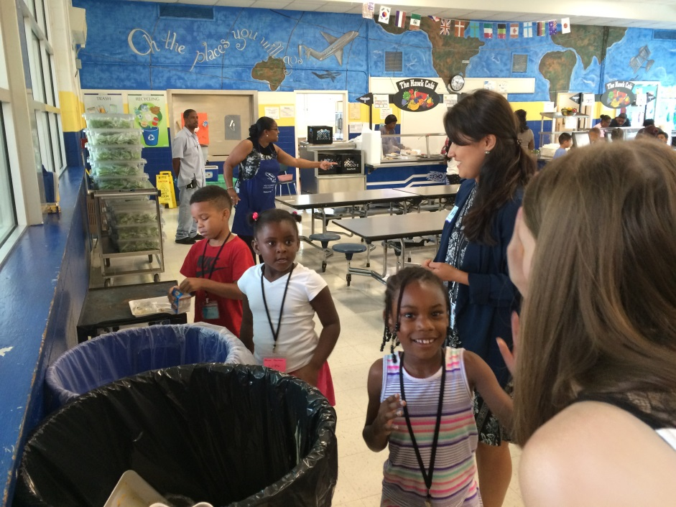
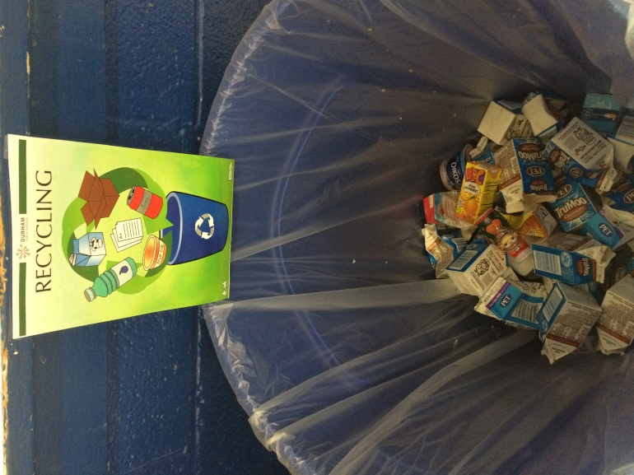
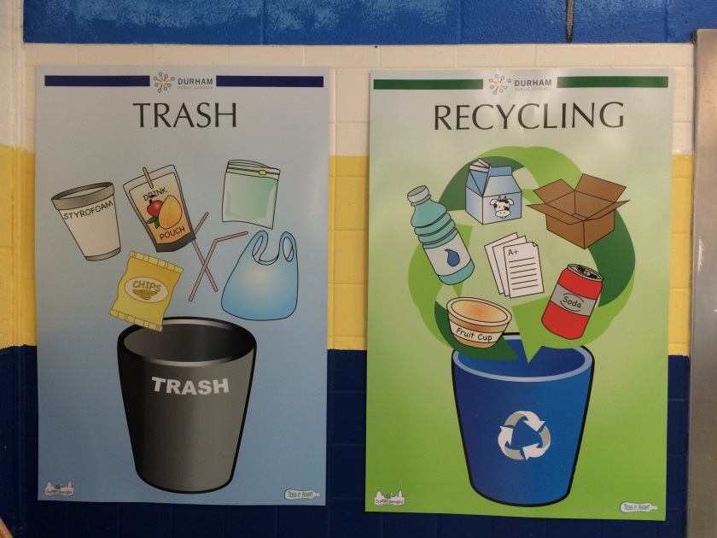
Recycling: Durham Public Schools

Slide 11
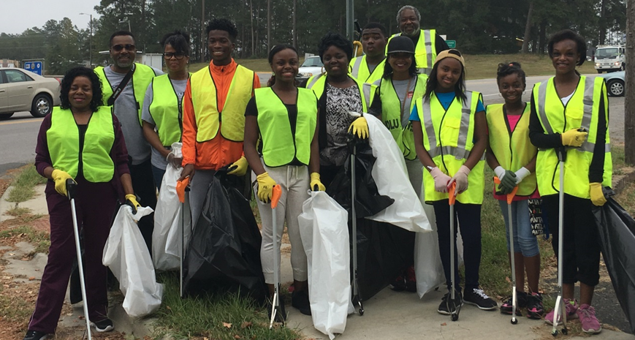
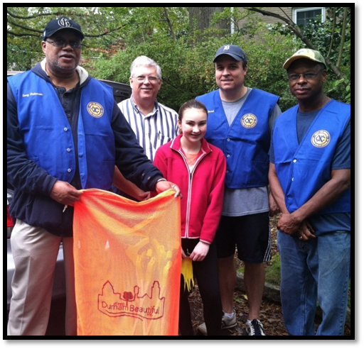
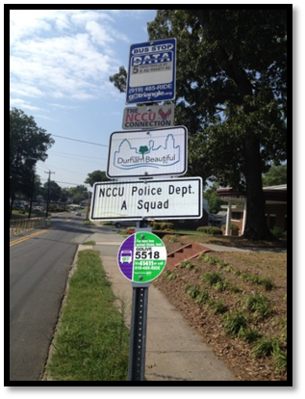
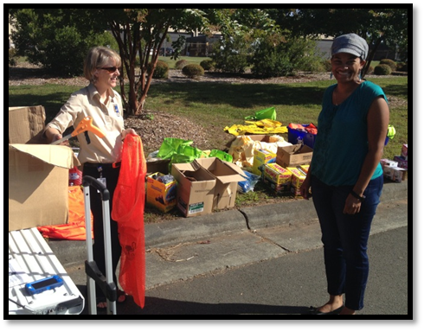
Litter Prevention: Adopt-a-Bus-Stop and Adopt-a-Street

Slide 12
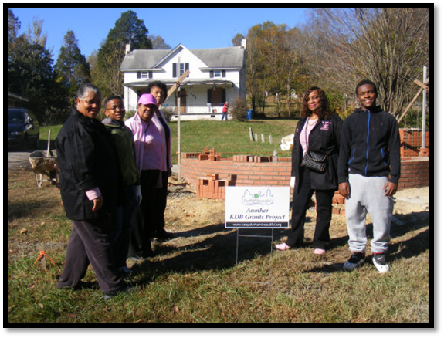
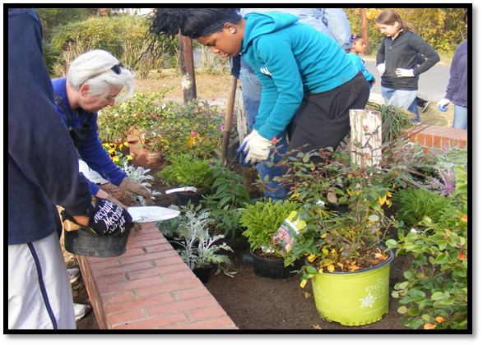
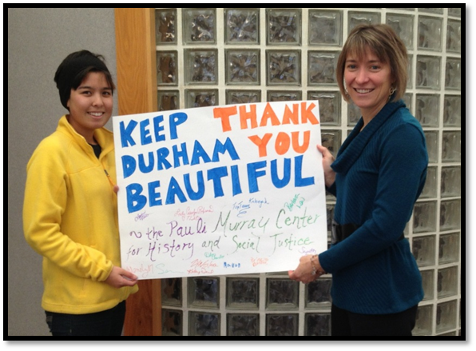
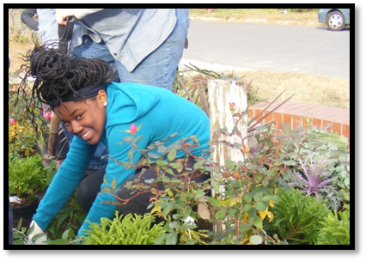
Community Beautification Grants
Notes:
500 + students, staff, and teachers helped plant orchard
Beautified the entranceway for the elementary school
Will provide a dynamic outdoor learning space
Will provide increase food access in an area of Durham that is on the Mayor’s poverty reduction target
18 fruit trees and shrubs planted, including native species such as paw paws, persimmons and figs!

Slide 13
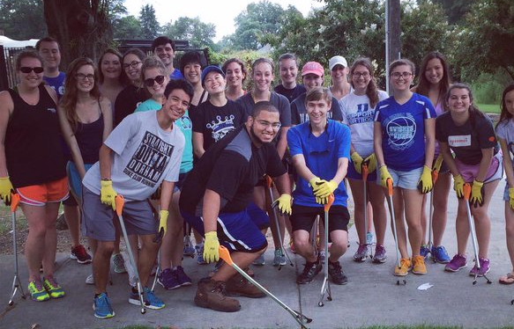
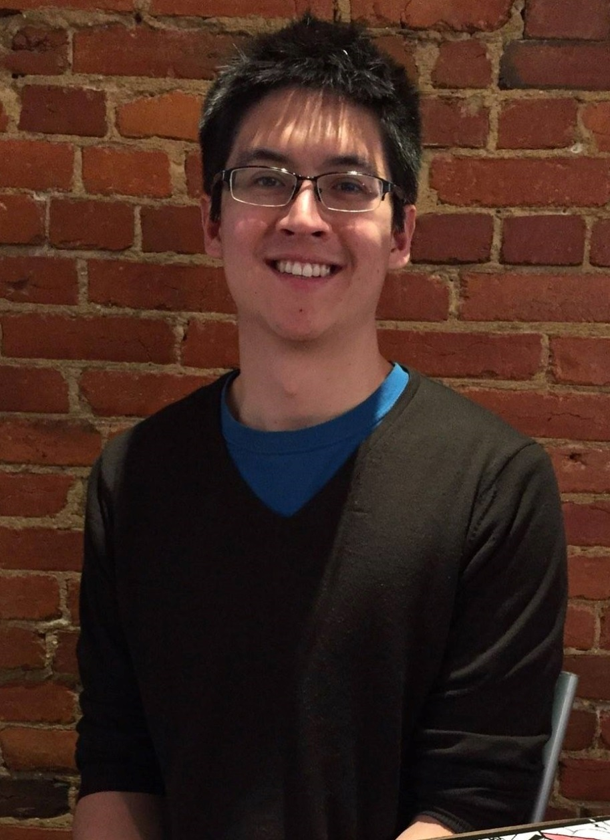
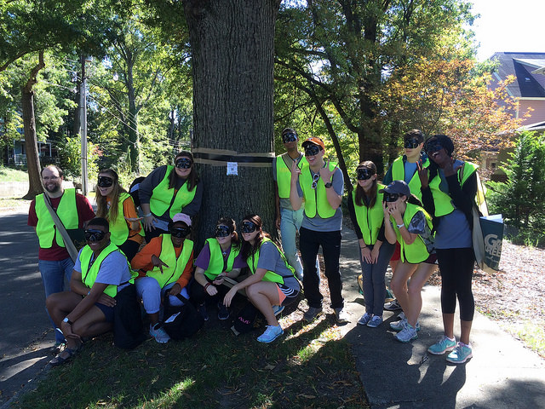
From Our Volunteers: Testimonials
“What we love about volunteering with Keep Durham Beautiful is that it’s very nice to be physically out in the community doing work that will have a lasting impact.”
- Jasper Hancock, Community Service Chair at the Sigma Chi Beta Lambda chapter at Duke University
Notes:
From our volunteers

Slide 14
Volunteer Opportunities
Special Activities
Litter cleanup , Cigarette Litter Prevention, Gardening, Recycling
Adopt-a-spot
Street, bus stop, stream, park
Adopt-a-Tree
Planting, Watering, Staking, Tree Care
Community Grants
Let us help your beautification dream happen in a community space
Schools
Recycling, Tree Planting, Community Gardening
Engaging & inspiring individuals to take greater responsibility for their community environment

Slide 15
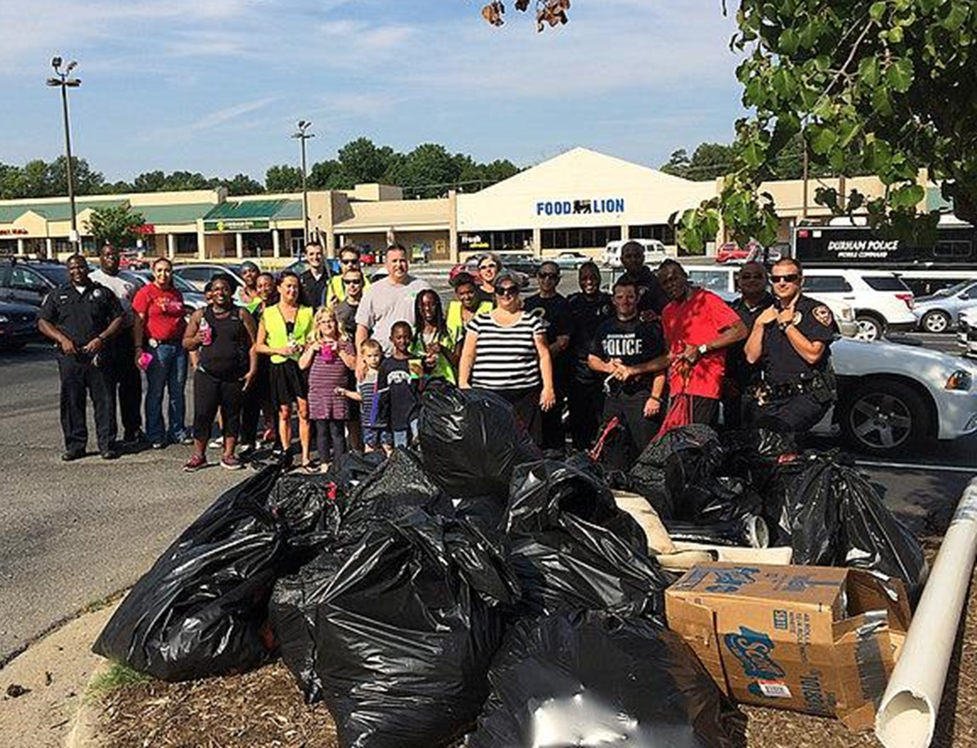
Help us facilitate Volunteer Power!
Engaging & inspiring individuals to take greater responsibility for their community environment

