Slide 1
2015 Durham County Cares Campaign
Recipient Organization Presentations
Thursday, September 17, 2015

Slide 2
2015 Durham County Cares Recipient Organizations
Community & Family Prosperity
Durham Rescue Mission
John Avery Boys & Girls Club
Health & Well-Being for All
Exchange Family Center/Exchange Clubs' Child Abuse Prevention Center
Senior PharmAssist, Inc.
Safe & Secure Community
Salvation Army Boys & Girls Club of Durham
Durham Crisis Response Center
Environmental Stewardship
Environmental Federation of North Carolina DBA: EarthShare North Carolina
Toxic Free NC
Miscellaneous/Multiple Area Services
Durham Center for Senior Life
United Way of the Greater Triangle

Slide 3
John Avery Boys & Girls Club

Slide 4
of Greater Durham
Notes:
You can click on the text box containing ‘OF ANY LOCATION’ and re-type your Club name.

Slide 5
To inspire and enable all young people, especially those who need us most, to realize their full potential as productive, caring, and responsible citizens.
Boys & Girls Club of Greater Durham Mission Statement
Notes:
Changed in 2001

Slide 6
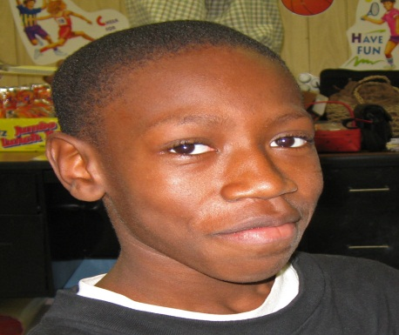
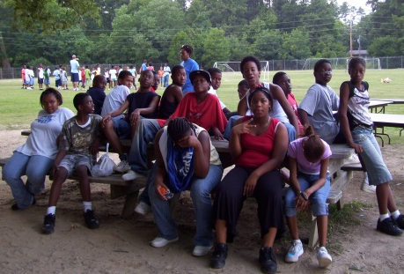
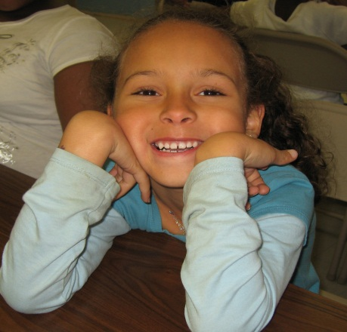
THE FACTS
57% of all juvenile crimes occur between 2 & 7 p.m. (U.S. Justice Dept.)
The most common activity for children after school is watching television - 23 hours per week (A.C. Nielson)
41% of Children in Durham County are overweight
It costs approximately $1,500 per year/child to provide programming in the Boys & Girls Club
It cost roughly $55,000 per inmate/year for juvenile incarceration (Communities in Schools, NC)
We can all pay a little now… or a lot later!
Notes:
1860: A cause is born…several women in Hartford, Conn., believing that boys should have a positive alternative to roaming the streets, organize the first club

Slide 7
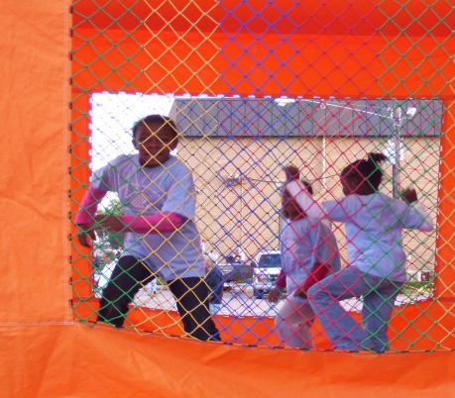
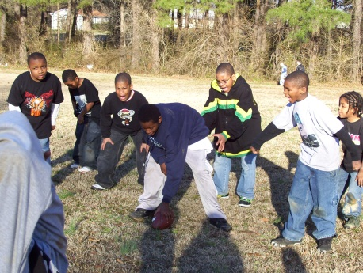
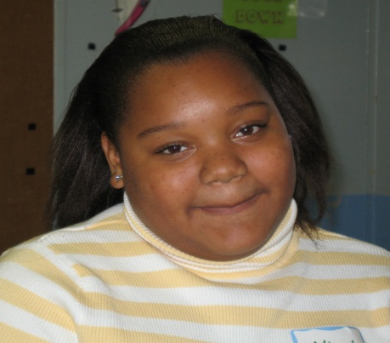
John Avery, Durham NC
Today Boys & Girls Clubs:
Serves more than 4.8 million children
Has over 4,000 Club locations
Is located in all 50 states, Puerto Rico, the Virgin Islands, plus domestic and international military bases
Employs approximately 44,000 trained professional staff
Notes:
Be sure to give the slide a title/name in case you need to refer to it later in the presentation. Be sure to keep your bullets short and precise.

Slide 8
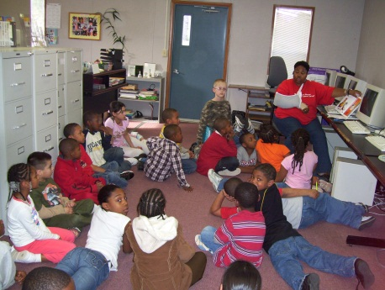
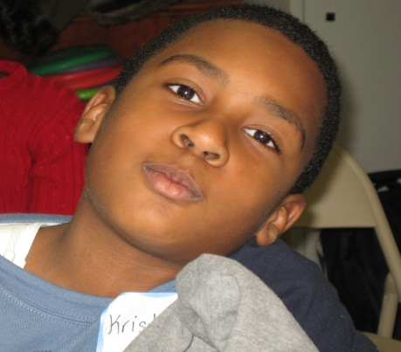
Our Core Beliefs:
A Boys & Girls Club provides:
A safe place to learn and grow
Ongoing relationships with caring, adult professionals
Life-enhancing programs and character development experiences
Hope and opportunity
Notes:
Four key characteristics define the essence of a Boys & Girls Club. All are critical in exerting positive impact on the life of a child.

Slide 9
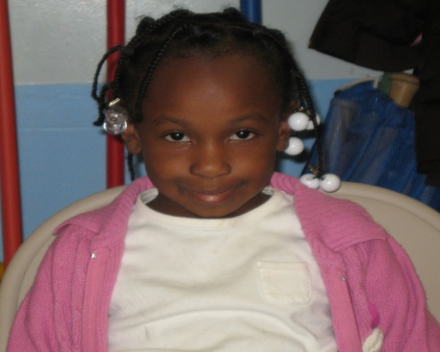
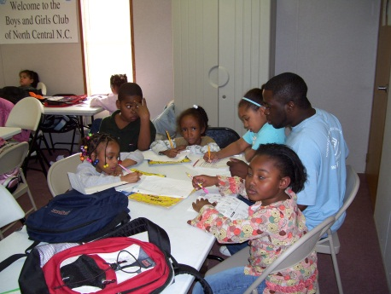
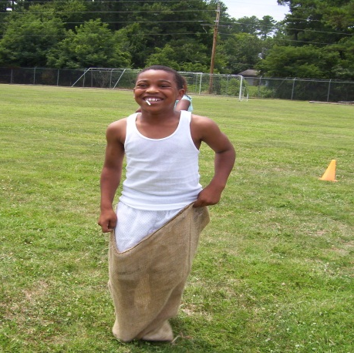
Dedicated Youth Facility:
The Boys & Girls Club of Greater Durham is a place designed solely for youth programs and activities. Our average daily attendance is 140 and our current membership is 512.
Notes:
Traditional Stand-alone facility is the ultimate goal.

Slide 10
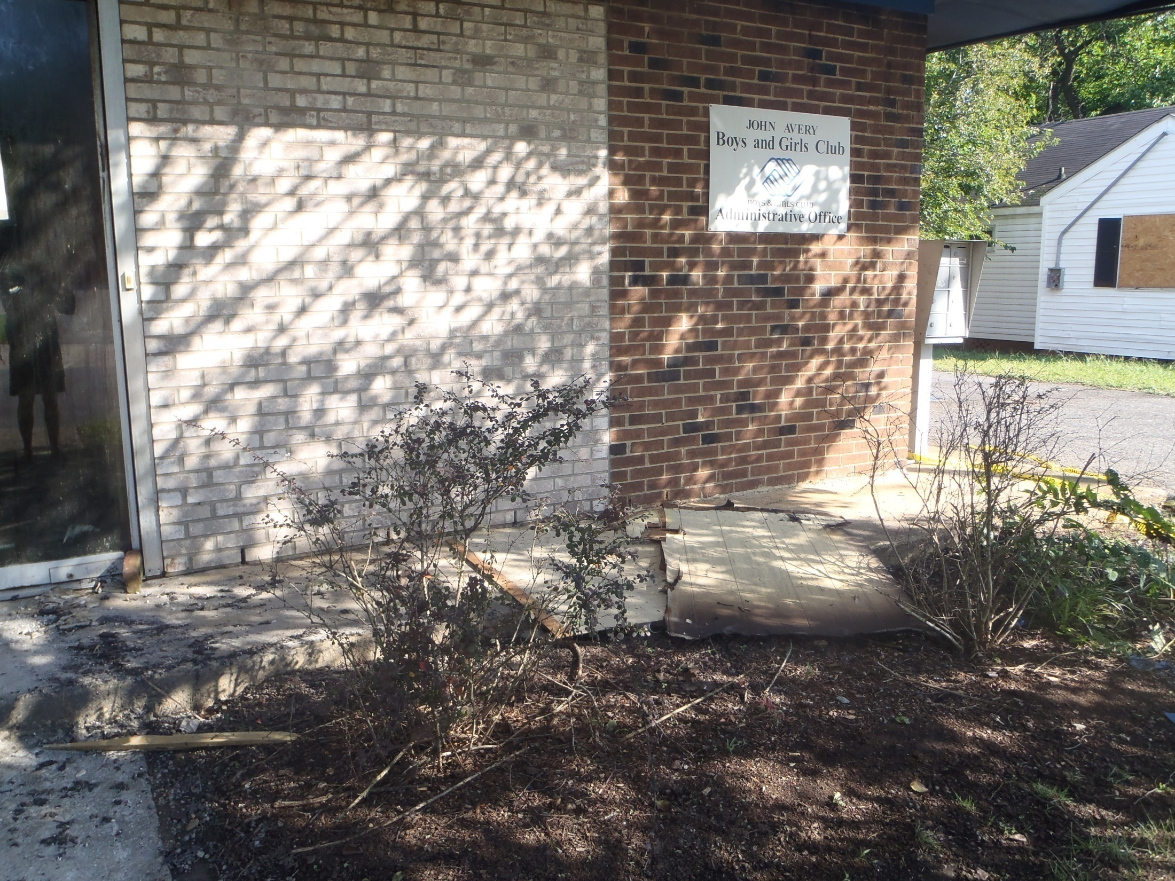

Slide 11
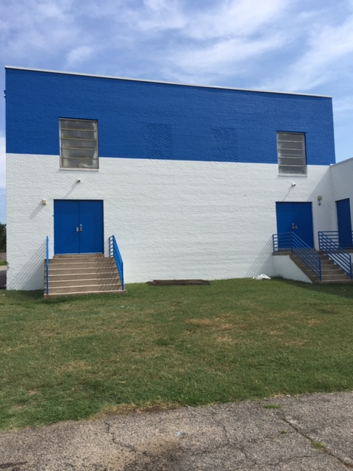

Slide 12
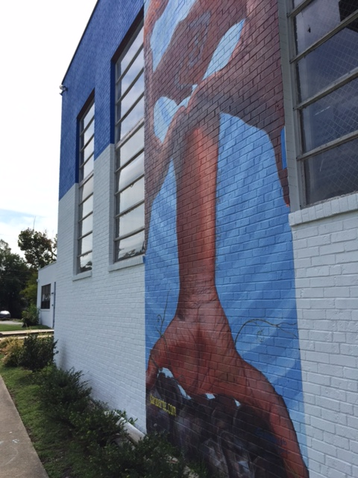

Slide 13
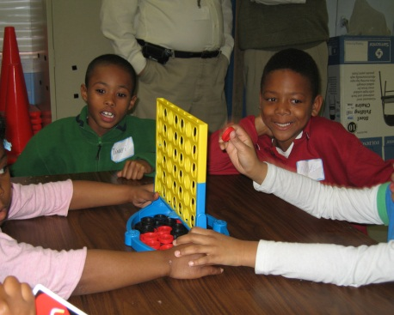
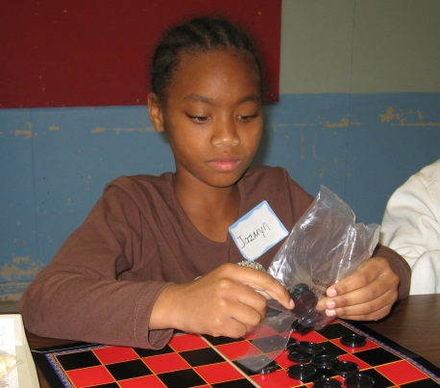
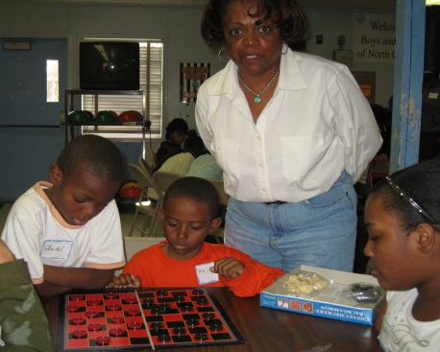
Of Greater Durham
Open Daily:
The Club is open every day after school, during the summer and when kids have free time and need positive, productive outlets.
Nutritional meals are provided to every child, every day as part of their membership.
Notes:
Be sure to give the slide a title/name in case you need to refer to it later in the presentation. Be sure to keep your bullets short and precise.

Slide 14
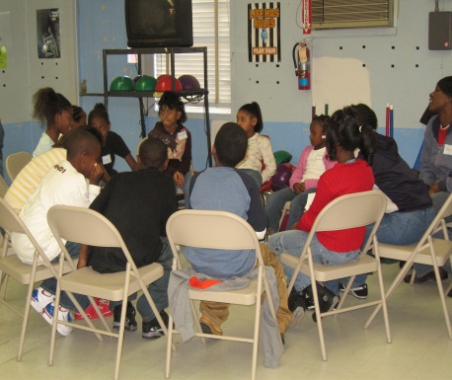
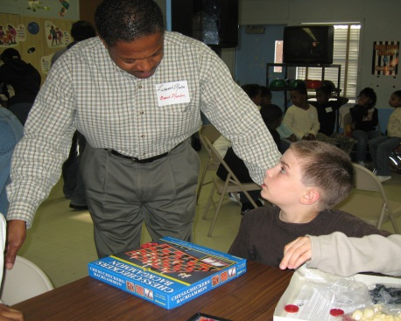
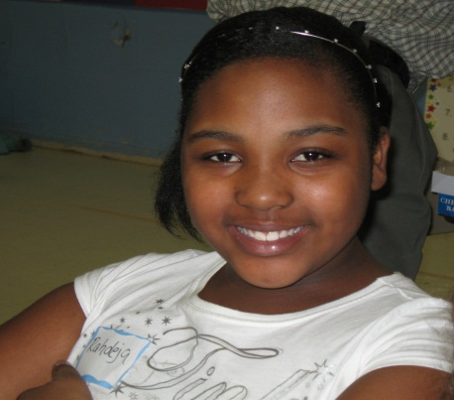
of Greater Durham
Professional Staff:
Our Club has highly trained, paid youth development professionals, providing positive role models and mentors. Volunteers provide key supplementary support.
Notes:
Be sure to give the slide a title/name in case you need to refer to it later in the presentation. Be sure to keep your bullets short and precise.

Slide 15
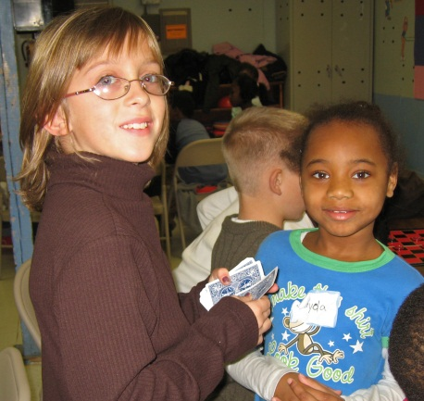
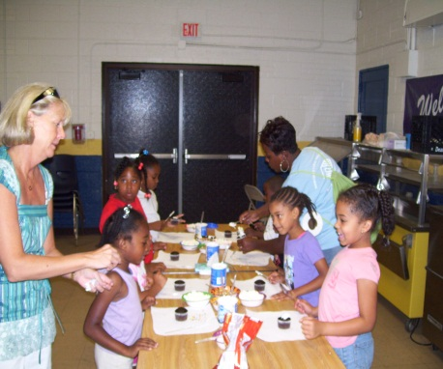
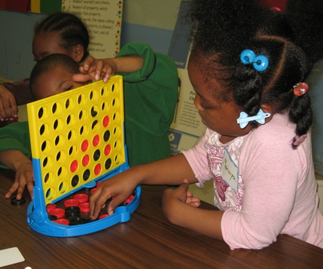
Affordable To All:
Dues are low (currently $10/year)
Children can also earn membership
Creates sense of ownership & pride
Establishes a sense of belonging
Creates a feeling of influence

Slide 16
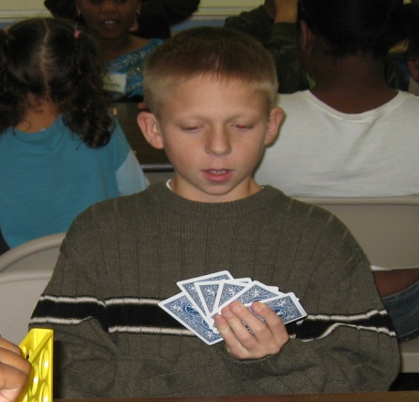
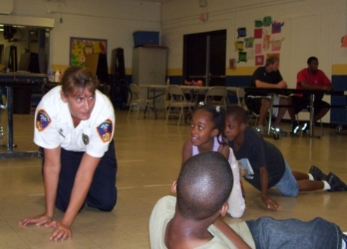
of Greater Durham
B&GCGD Programs:
Meet members’ needs & interests
Build on members’ strengths
Staffed by qualified professionals
Promote learning & healthy development
Focus on achieving specific outcomes
Continually assessed and evaluated
Notes:
Be sure to give the slide a title/name in case you need to refer to it later in the presentation. Be sure to keep your bullets short and precise.

Slide 17
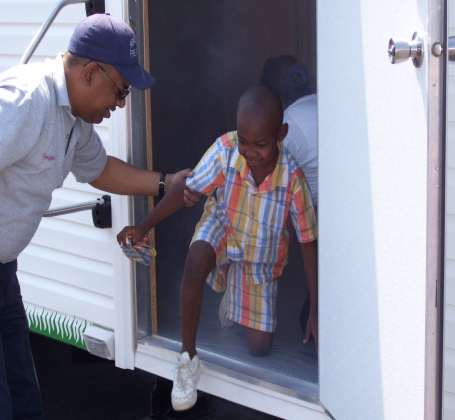
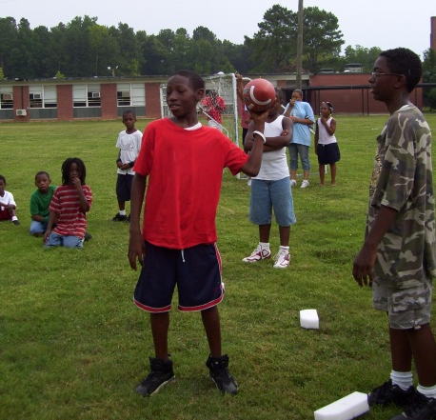
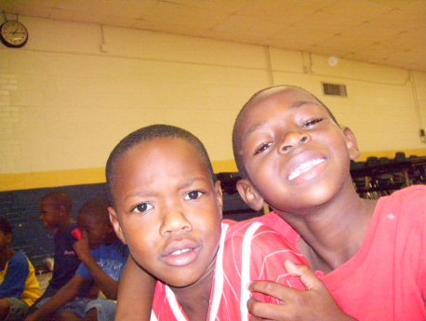
of Greater Durham
Youth Development Outcomes:
Positive self-identity
Educational, employment, social, emotional and cultural competencies
Community and civic involvement
Health and well-being
Moral compass
Notes:
Be sure to give the slide a title/name in case you need to refer to it later in the presentation. Be sure to keep your bullets short and precise.

Slide 18
of Greater Durham
5 Core Program Areas:
Character and Leadership Development
~Torch and Keystone Clubs, YOY
Education and Career Development
~Skill Tech, Power Hour, Career Prep
Health and Life Skills
~ Child Safety, SMART Moves
The Arts
~Fine Arts Programs
Sports, Fitness, and Recreation
~Triple Play
Notes:
1. Torch Clubs Torch Clubs are chartered small-group leadership and service clubs for boys and girls ages 11-13. Torch Club members elect officers and work together to plan and implement activities in four areas: service to Club and community, education, health and fitness, and social recreation.
2. Skill Tech: A Club Tech Basic Skills Program Skill Tech is a comprehensive basic computer skills curriculum for Club members ages 6-18 featuring fun, hands-on and age-appropriate lessons for four age groups. Rather than learning by rote all the functions of various software programs, participants perform activities toward the completion of larger projects, mastering valuable computer skills along the way.
3. Child Safety and Protection Developed with the National Center for Missing and Exploited Children, this program helps Clubs ensure the safety and protection of children through training for Club professionals and volunteers, a skill development and safety awareness curriculum for Club members ages 6-13, peer leader involvement, as well as parent and community awareness and participation.

Slide 19
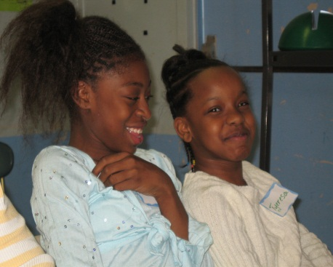
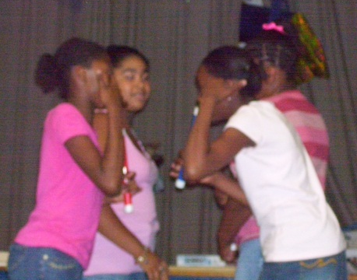
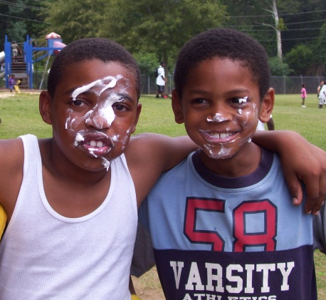
Our Progress:
Based on our Spring 2015 Report Card Grades
Math average scores: 81
Reading average scores: 83
Science average scores: 85
Social Studies average scores: 87
Physical Education average scores: 91
Notes:
conducted by Louis Harris & Associates

Slide 20
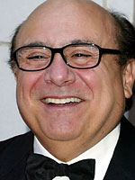
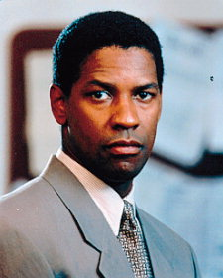
Why Boys & Girls Clubs?
Results from the 2014 BGCA National Alumni Survey:
57% of alumni said the Club saved their life
91% of alumni are satisfied with their adult life
90% of alumni are graduating from high school, compared to 85% at the national level
81% of alumni said the Club helped them develop a sense of responsibility to give back to their communities
Notes:
conducted by Louis Harris & Associates

Slide 21
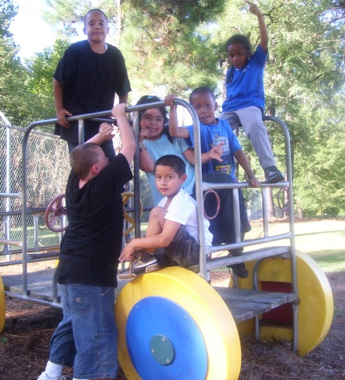
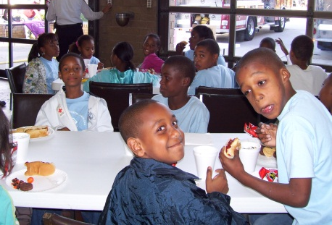
of Greater Durham
Program Outcomes:
72% of our members would receive their last meal at school
68% would go home w/out adult supervision
61% would go to gang identified territory during peak recruitment periods
4 consecutive years: no teen pregnancies and no contact with law enforcement.
Notes:
Be sure to give the slide a title/name in case you need to refer to it later in the presentation. Be sure to keep your bullets short and precise.

Slide 22
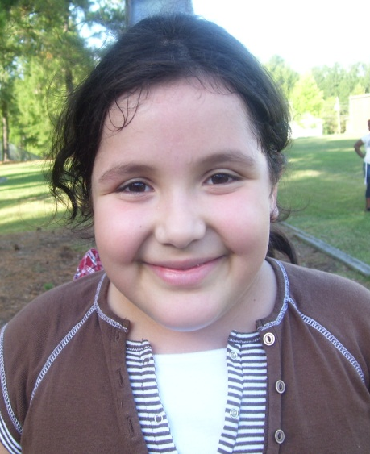
of Greater Durham
Please join us in this rare opportunity….
~ To Shape Futures
~ To Save Lives
~ To Strengthen Our Community
Notes:
Be sure to give the slide a title/name in case you need to refer to it later in the presentation. Be sure to keep your bullets short and precise.

Slide 23
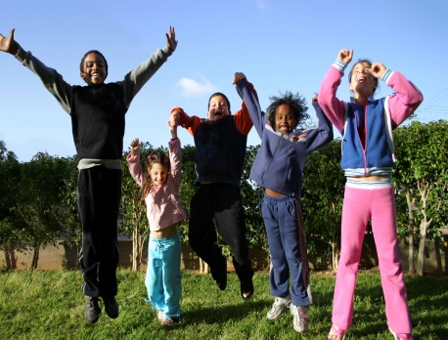
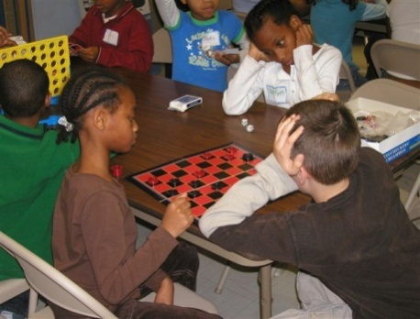
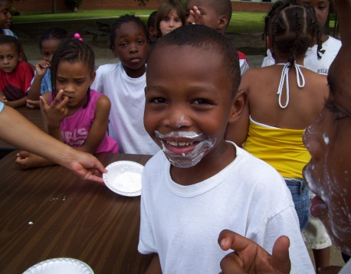
Boys & Girls Club of Greater Durham
For more information about the Club or to volunteer, contact:
Jerome Levisy, Chief Executive Officer
Phone: 919-687-4517
email: jlevisy@johnavery.org
808 Pettigrew Street
Durham, NC 27701

Slide 24
CLICK HERE
TO DONATE NOW

