Slide 1
2015 Durham County Cares Campaign
Recipient Organization Presentations
Thursday, September 17, 2015

Slide 2
2015 Durham County Cares Recipient Organizations
Community & Family Prosperity
Durham Rescue Mission
John Avery Boys & Girls Club
Health & Well-Being for All
Exchange Family Center/Exchange Clubs' Child Abuse Prevention Center
Senior PharmAssist, Inc.
Safe & Secure Community
Salvation Army Boys & Girls Club of Durham
Durham Crisis Response Center
Environmental Stewardship
Environmental Federation of North Carolina DBA: EarthShare North Carolina
Toxic Free NC
Miscellaneous/Multiple Area Services
Durham Center for Senior Life
United Way of the Greater Triangle

Slide 3
United Way of the Greater Triangle

Slide 4
2015 United Way Campaign
REAL. UNITED. CHANGE.

Slide 5
The Triangle Paradox
2014 National Accolades | The Stark Reality for Some
EDUCATION Raleigh #7 smartest city (Forbes) Chapel Hill #1 best small cities for education (Movoto) Raleigh #2; Durham #3 most educated metros (WalletHub) | In the Triangle, 55% of all students perform at grade level on math (grade three) - Only 30% of economically disadvantaged students can meet this standard vs. 72.6% of non-economically disadvantaged students In the Triangle, 52.5% of all students perform at grade level in reading (grade three); Only 27.3% of economically disadvantaged students can meet this standard vs. 70% of non-economically disadvantaged students
ECONOMICS #1 Best Place for business and careers (Forbes) Raleigh Metro area #2 best cities for young professionals (Forbes) | Ranks 94th in the nation in social mobility and 92nd in measurement of inequality (MDC report) 13% of total residents in the Triangle have income below the poverty level, compared to 17.9% in NC. In three of our counties, Durham, Orange and Johnston percentages are all above 16% (Wake’s 10.7% affects the Triangle’s average)
QUALITY OF LIFE Cary #19; Chapel Hill #30 best places to live (Money) Raleigh-Durham #4 happiest cities (University of British Colombia) Raleigh #1 US city attracting the most families (Forbes) | The number of people in poverty has increased 96.8% from 2000 to 2008-2012 (MDC report) In the Triangle, 21.3% of children are food insecure, compared to 26.7% in NC - Mecklenburg 22.3%; Guildford 23.4%; Austin, TX 21.4%
Chapel Hill #3 and Durham #10 most caring cities (Movoto) | 3.75% of Triangle residents make charitable contributions compared to 4.38% in NC - Philanthropy as percentage of income, the Triangle trails both Winston-Salem and Charlotte

Slide 6
United Way of the Greater Triangle
We are creating the United Way for our times.
No longer simply a fundraiser, we are funders and community partners. A catalyst for change in the Triangle area with a solutions-oriented approach built on collaboration, innovation, and the power of a community united for good.

Slide 7
What United Way of the Greater Triangle Does
Changing Generations: Pathways to Progress for Families and Children:
A two-generational approach of supporting and building – not just funding – collaborative work that will help create, scale and sustain solutions that foster self-determination and generational success for adults and their children together.
We now have 24 Collaboratives in place across the region doing this work.

Slide 8
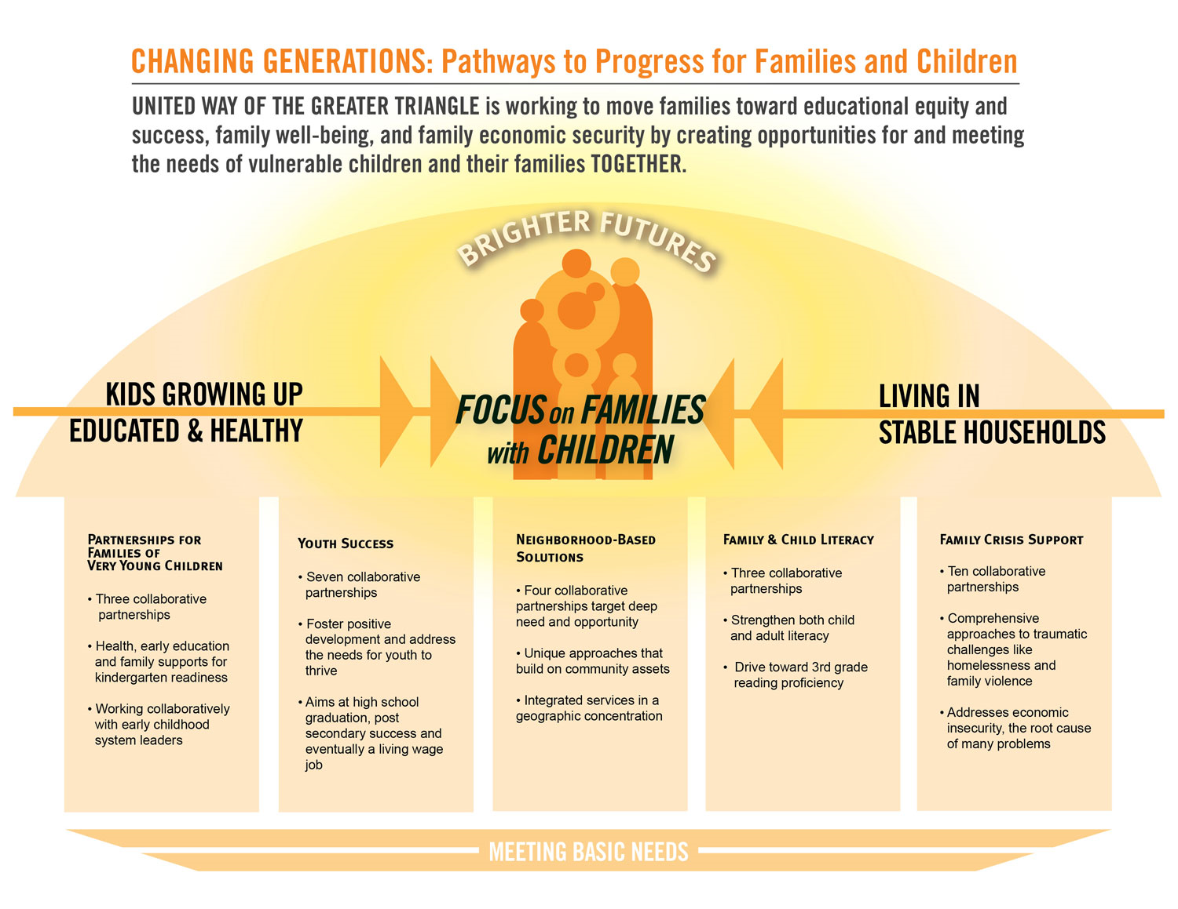

Slide 9
What United Way of the Greater Triangle Does
Meeting Immediate Basic Needs:
Continued support for our most vulnerable populations in accessing their basic needs of healthcare, housing, and safety.
This component includes an initiative focused on building a food-secure community for all with an emphasis on ending childhood hunger.

Slide 10
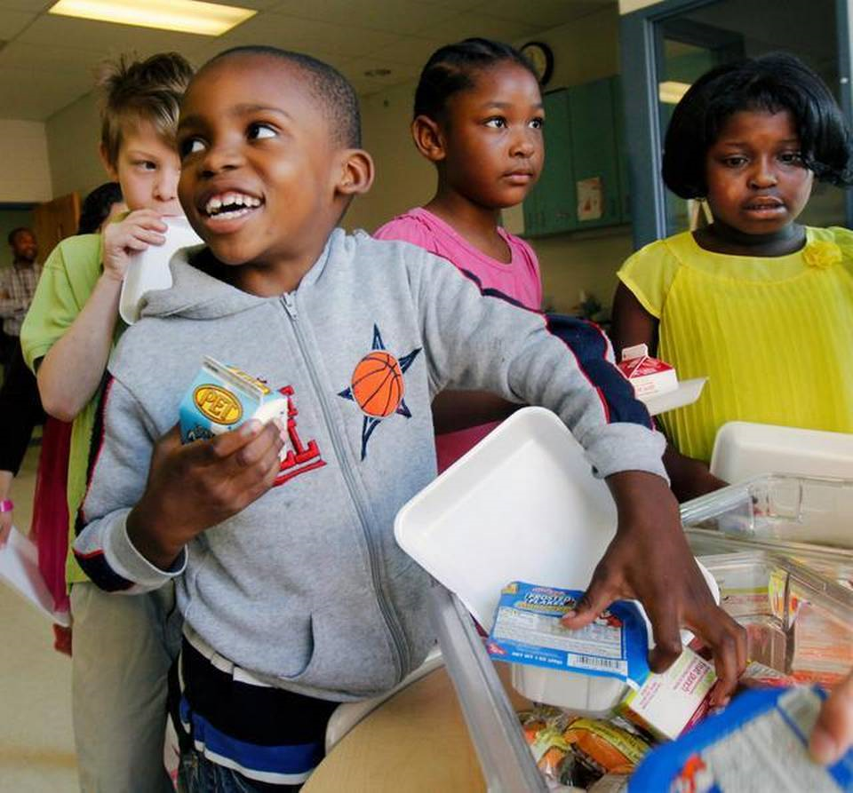
What United Way of the Greater Triangle Does
Social Innovation Challenge 2014: 100k Kids Hungry No More
40 innovative ideas submitted to end childhood hunger from the community
12 semi-finalists
4 finalists
Winner implemented and is scaling a food distribution system to schools in Durham County.
934 more children receive breakfast every day in Durham County.
Photo credit: News & Observer

Slide 11
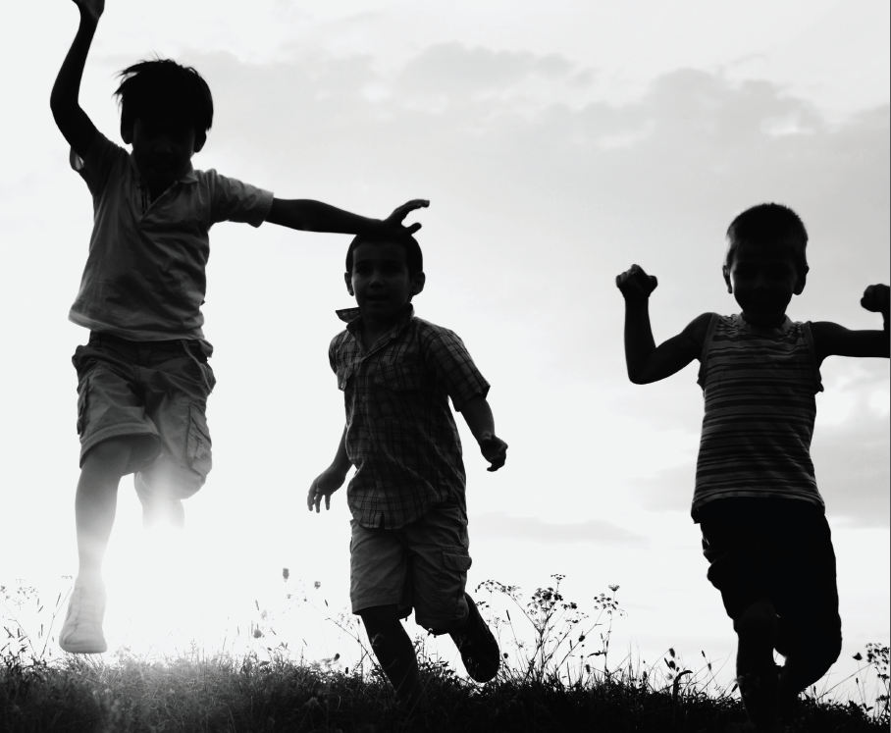

Slide 12
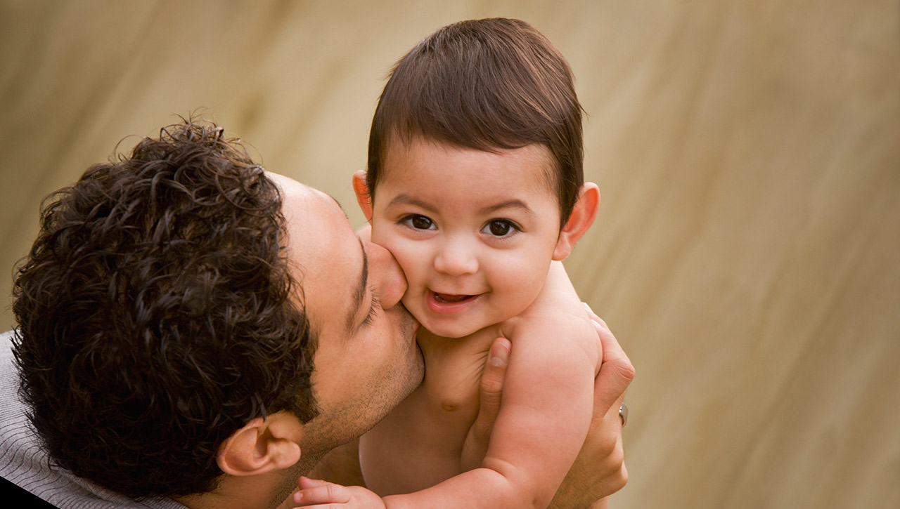
We Cannot Create Change Alone
We need your help.
We are committed to mobilizing the caring power of our community to build resources, foster collaborations and fuel the innovative spirit of the Triangle.

Slide 13
Join the Movement
VOLUNTEER
Learn how you can contribute your time and talents by visiting www.unitedwaytriangle.org/volunteers.
GIVE
A gift to the Community Impact Fund is a comprehensive approach to basic needs and long-term solutions to create meaningful changes in the lives of families and children.
TAKE ACTION
Share what you learned today with others.
@UWTriangle #Uniting4Good

Slide 14
Thank you for listening and for your support of United Way of the Greater Triangle. Now it’s time for trivia!

Slide 15
CLICK HERE
TO DONATE NOW

