Slide 1

2015 Durham County Cares Campaign
Recipient Organization Presentations
Thursday, September 17, 2015

Slide 2
2015 Durham County Cares Recipient Organizations
Community & Family Prosperity
Durham Rescue Mission
John Avery Boys & Girls Club
Health & Well-Being for All
Exchange Family Center/Exchange Clubs' Child Abuse Prevention Center
Senior PharmAssist, Inc.
Safe & Secure Community
Salvation Army Boys & Girls Club of Durham
Durham Crisis Response Center
Environmental Stewardship
Environmental Federation of North Carolina DBA: EarthShare North Carolina
Toxic Free NC
Miscellaneous/Multiple Area Services
Durham Center for Senior Life
United Way of the Greater Triangle

Slide 3

Durham Crisis Response Center

Slide 4

Durham Crisis Response Center
Services for victims of domestic & sexual violence
206 N. Dillard Street
Durham, NC 27701
919-403-94 Administrative
919-403-6562 Crisis Line
919-519-3735 Spanish Crisis Line

Slide 5
Our vision
To eradicate domestic and sexual violence in our community.

Slide 6
OUR Mission
To work with the community to end domestic and sexual violence through advocacy, support, education and prevention

Slide 7
Durham Crisis Response Center
(DCRC)
is the only agency in Durham County whose sole mission is to provide comprehensive domestic and sexual violence crisis intervention and supportive services.

Slide 8

Programs & Services
  24-hour crisis line
  Emergency Shelter
  Transitional Housing
  Hospital Response
  Sexual Assault Services
  Legal Advocacy
  Support Groups
  Individual Counseling
  Safety Programming
  Community Outreach & Education/Awareness
  Rape Prevention Education
All services are free and confidential

Slide 9

24-hour Crisis Line
The crisis line services as the “gateway” to all services offered by DCRC.
  Calls are confidential
  In 2014, we received approximately 3,200 crisis calls
    Responded to 68 hospital calls
    13,816 crisis line volunteer hours
  Have a dedicated Spanish Crisis Line
  TTY line is available to those with a hearing disability

Slide 10

Emergency Shelter
Offers temporary shelter for those fleeing violent & dangerous situations and provides a supportive environment in a confidential location.
In 2014, DCRC sheltered 314 women & children
  135 women were turned away for lack of space – not including the number of children who might have come with them
Services include counseling, case management, legal advocacy, safety planning, financial literacy, referrals & information
Only 18 available beds

Slide 11
Transitional Housing
Offers women and their families the opportunity to transition from shelter into long-term independent, violence-free living for up to 18-months.
Provides services such as case management, employability skills, financial management training, individual counseling, support group counseling, etc.

Slide 12

Non-Residential Services
Not everyone needs to come into our residential program. This component offers a myriad of services:
  Hospital accompaniment
  Court accompaniment
  Safety Planning
  Case Management
  Support Groups
  Individual Counseling
  Legal Advocacy
All services are available in Spanish

Slide 13

Sexual Assault Services
In 2014, DCRC assisted 156 sexual assault victims with services such as:
  Case management
  Worked with family members and loved-ones
  Hospital accompaniment in the hours directly after the rape, providing support through the forensic examination
  Safety planning
  Counseling
  Court Accompaniment
  Group Counseling

Slide 14

Support Groups & Individual Counseling
A Therapeutic Counselor provides supervision for all individual & group counseling. Support groups encourage participants to explore their experiences with fellow survivors in a safe & supportive environment.
  DV & SA support groups
  Hispanic/Latina support group
  Individual counseling for survivors and for secondary victims (family members & loved-ones)

Slide 15
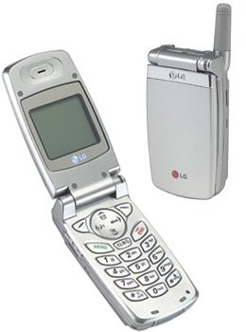
Safety Programs
911 Ready Cell Phones
  Distributed directly to survivors for emergency contact only
  Collected & redeemed for financial support to agency
  Cell phone collection is a great volunteer effort for DCRC
Address Confidentiality Program
ADT home alarm systems
Lethality Assessments
Safety Planning

Slide 16

Community Outreach & Education
OUTREACH: Victims of sexual or domestic violence come from ever economic or social group, regardless of race, gender or ethnicity. Therefore it is imperative that we actively seek them out through presentations in the community.
EDUCATE: We also make educate presentations to inform the community about domestic & sexual violence.
  In 201 4 made 105 community presentations
  Civic organizations, faith-based groups, workshops & trainings, schools, universities
  Held Community Commemorative Events such as Domestic Violence (Oct) and Sexual Assault (April) Awareness Months
Facilitate Domestic Violence & Sexual Assault Response Teams

Slide 17

Rape Prevention Education
The goals is to impact the attitudes, beliefs and behaviors that lead to sexual violence.
  Programs, workshops and trainings to help reduce the incidences of sexual violence in our community
  Youth Educator is providing evidence-base curriculum to teens about the correlation between alcohol – sexual Harassment, Date Rape, Dating Violence Prevention

Slide 18


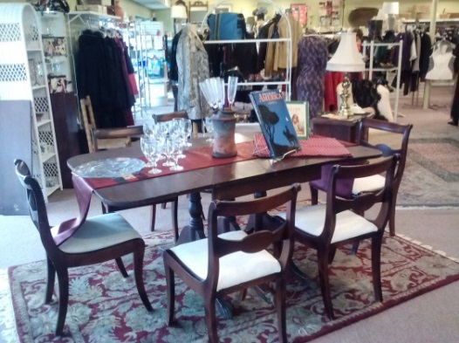
“Thrift Boutique”
Pennies for Change is Located at:
  2715 Durham-Chapel Hill Blvd [919-237-2167]
  PFC is an upscale resale shop
  All proceeds from sales support the operation of DCRC
  Clients receive clothing & household items free of charge as they transition into violence-free living

Slide 19

Volunteer Opportunities
Direct Services
  Crisis Line Advocate
  Spanish Crisis Line
  Hospital Response
  Court Advocacy
  Child Care for Support Groups (English & Spanish)
Administrative
PFC Thrift Store
Fundraising & Special Events

Slide 20
More Volunteer Opportunities
Shelter Services
  “Granny-for-a-Day”
  Overnight Volunteers
  “Dinner’s On Us”
Community Education
  Speaker’s Bureau
  Outreach Presentations
  Marketing & Media
Professional Services & Skills
  Carpentry, financial, office/administrative, website, lawn care, etc.
Special Research Projects:
  Court Watch, Legislative Review
  “If you have a skill, we can probably use it!”

Slide 21
Contact Information
Administrative Line: 919-403-9425
Crisis Line: 919-403-6562
Spanish Line: 919-519-3735
www.durhamcrisisresponse.org
http://www.facebook.com/dcrc206
http://twitter.com/DCRC206

Slide 22

CLICK HERE
TO DONATE NOW

