Slide 1

2015 Durham County Cares Campaign
Recipient Organization Presentations
Thursday, September 17, 2015

Slide 2
2015 Durham County Cares Recipient Organizations
Community & Family Prosperity
Durham Rescue Mission
John Avery Boys & Girls Club
Health & Well-Being for All
Exchange Family Center/Exchange Clubs' Child Abuse Prevention Center
Senior PharmAssist, Inc.
Safe & Secure Community
Salvation Army Boys & Girls Club of Durham
Durham Crisis Response Center
Environmental Stewardship
Environmental Federation of North Carolina DBA: EarthShare North Carolina
Toxic Free NC
Miscellaneous/Multiple Area Services
Durham Center for Senior Life
United Way of the Greater Triangle

Slide 3

Durham Rescue Mission

Slide 4


Slide 5
Mission Statement
Our Mission is to meet through the power of Jesus Christ the needs of the whole person: spiritual, educational, emotional, physical, social, and vocational, so that those who are hurting may become fully functioning members of society.

Slide 6
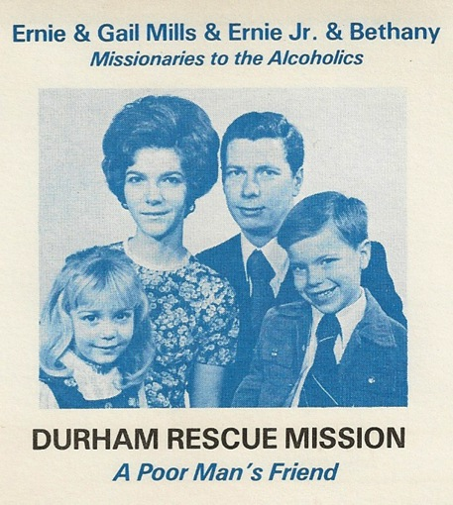
Addiction is Close to Home
Father
Mother
Son
Daughter
Brother
Sister
Aunt
Uncle
Grandparent
Nephew
Niece
Cousin
There may be an addict in your family

Slide 7
Temps to the Rescue
In 2014
315 People
Got Jobs!

Slide 8
We’re #1!
Charity Navigator is the nation’s largest and most utilized evaluator of charities.
Charity Navigator ranks the Durham Rescue Mission the #1 Homeless Services Provider in the Carolinas.
This is our 3rd year earning the four star
#1 Charity Navigator ranking!

Slide 9
2015 Durham County Point in Time Count Revealed:
64% of Homeless Choose to Come to the Durham Rescue Mission
Homeless Choose Mission

Slide 10
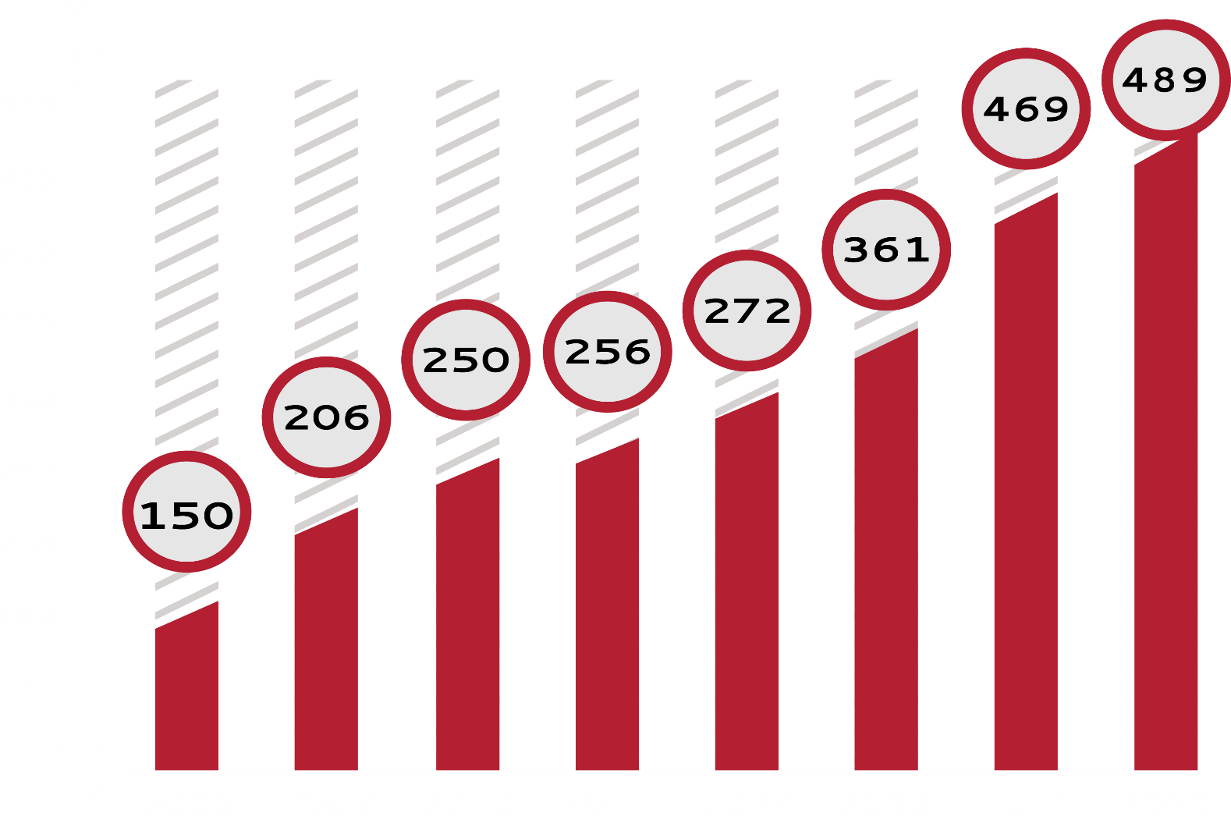

2015 Statistics

Slide 11
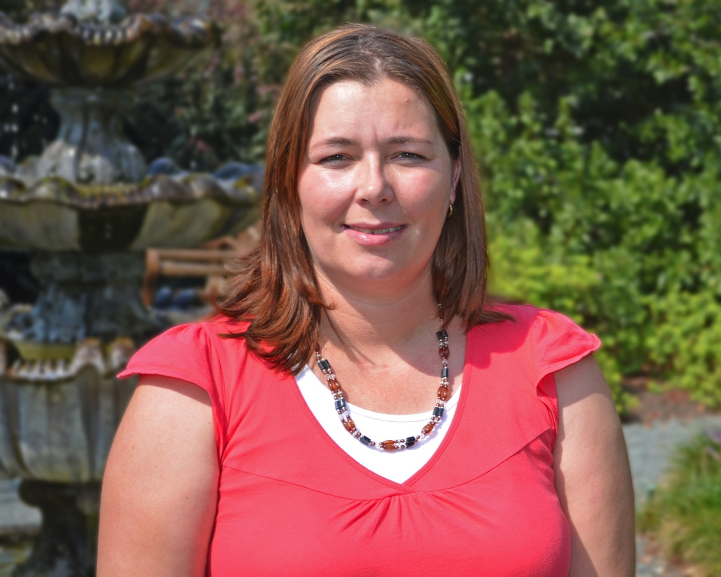
Brandy Ammons
Teaching Drug Addiction Classes

Slide 12
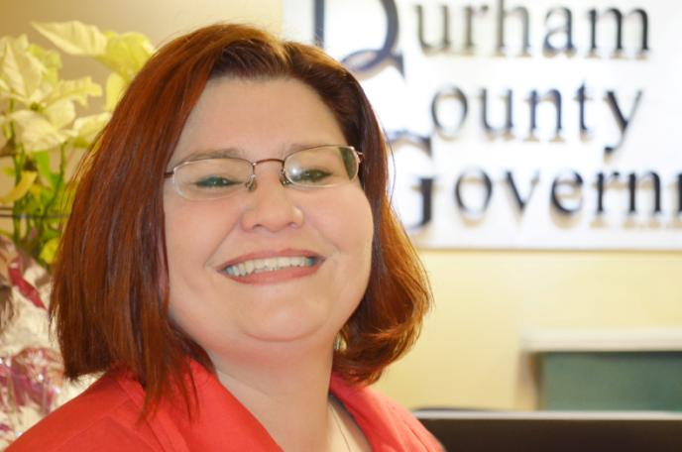
Karen Ramsey
A Tax Assistant in the County Manager’s Office

Slide 13
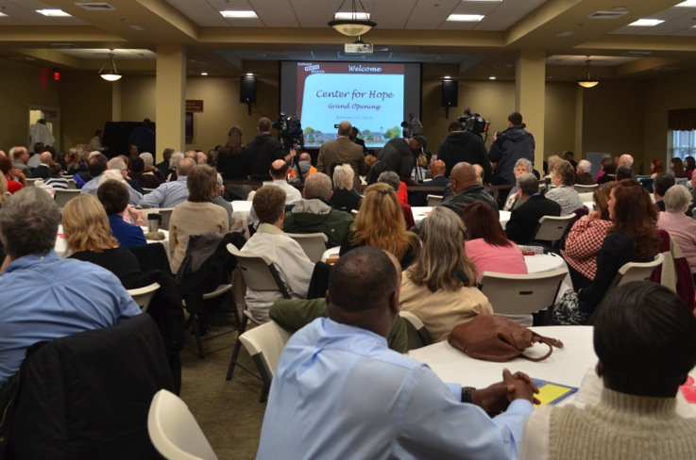
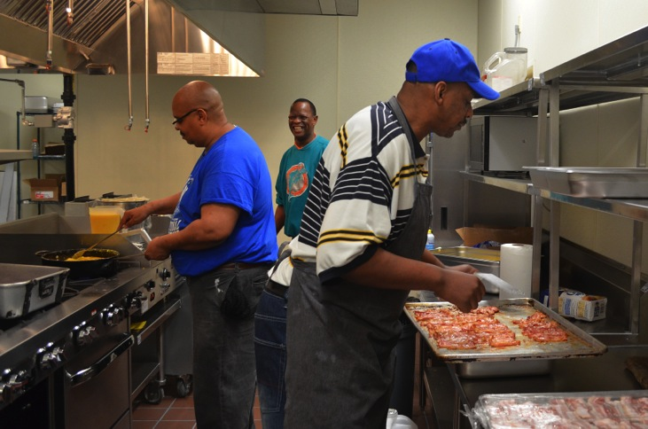
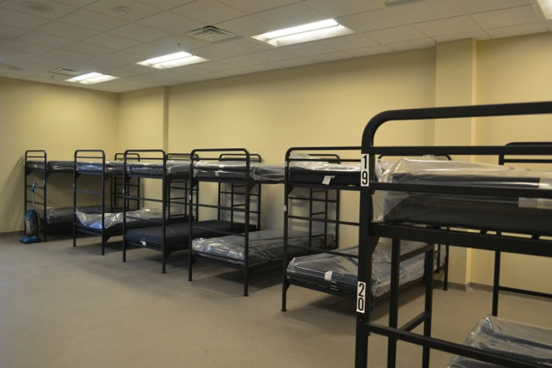
Center for Hope
Clegg Dining Hall
Seats 250
Sandra Peterson
Kitchen
Elton Earp Dormitory
3 Dorms
88 Beds

Slide 14
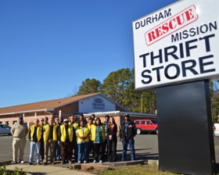
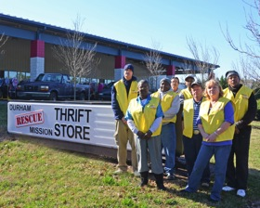
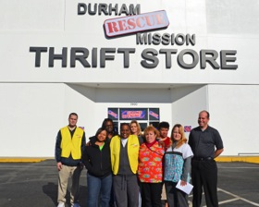
Thrift Stores
Durham Rescue Mission Thrift Store RTP
3220 Hwy 55
Durham, NC 27713
919-401-1935
Durham Rescue Mission Thrift Store Brier Creek
10701 Glenwood Ave
Raleigh, NC 27617
919-401-1935
Durham Rescue Mission Thrift Store Chapel Hill
3900 Chapel Hill Blvd.
Durham, NC 27707
919-401-1935
Your donations will help maintain 70 jobs

Slide 15
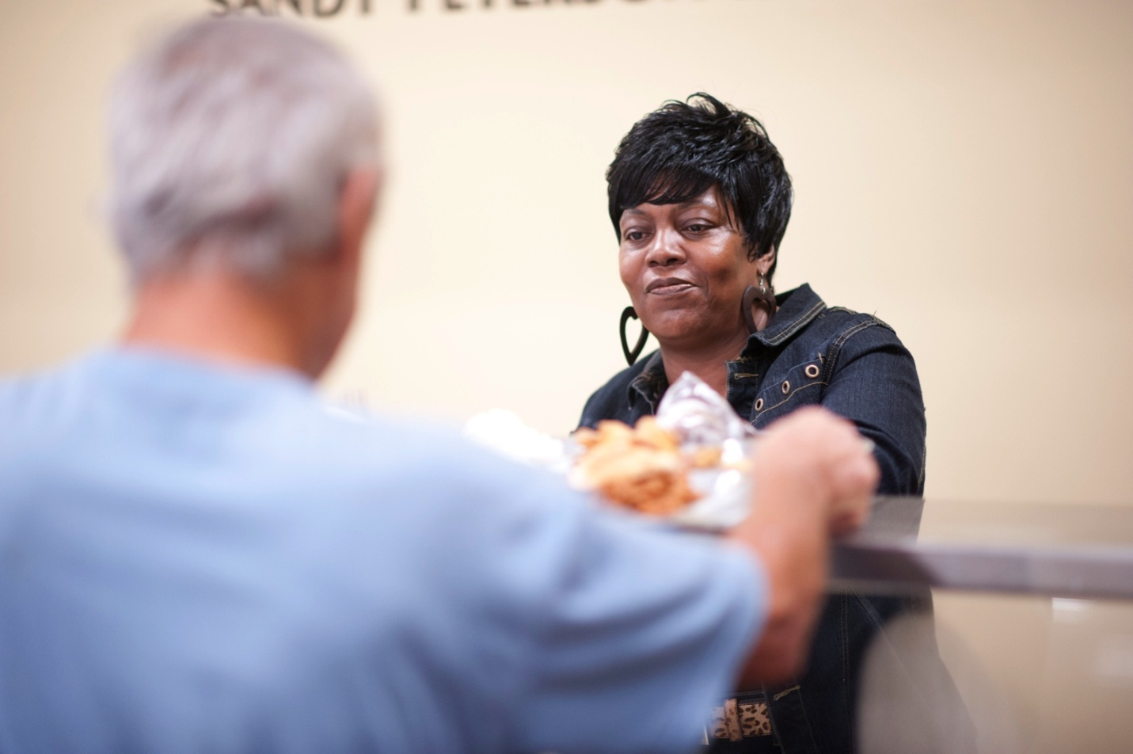
Volunteer to Serve a Meal
Hope Often Starts with the Love from Our Volunteers
At either our men’s division or women and children’s division

Slide 16
YOU can make a Difference
HOW you can make a difference:
  Volunteer
  Tell others about the Mission
  3. Donate

Slide 18

CLICK HERE
TO DONATE NOW

