Slide 1


Slide 2
Mission Statement
Our Mission is to meet through the power of Jesus Christ the needs of the whole person: spiritual, educational, emotional, physical, social, and vocational, so that those who are hurting may become fully functioning members of society.

Slide 3
We’re #1!
Charity Navigator is the nation’s largest and most utilized evaluator of charities.
Charity Navigator ranks the Durham Rescue Mission the #1 Homeless Services Provider in the Carolinas.
This is our 3rd year earning the four star
#1 Charity Navigator ranking!

Slide 4
ADDICTION IS CLOSE TO HOME
Father
Mother
Son
Brother
Daughter
Aunt
Grandparent
Sister
Nephew
Uncle
Niece
Cousin

Slide 5
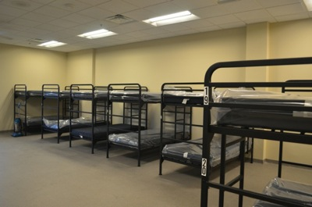
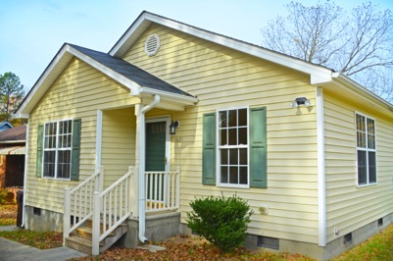
Helping those in need…..
Emergency
Beds
Transitional
Beds
Supportive
Beds

Slide 6
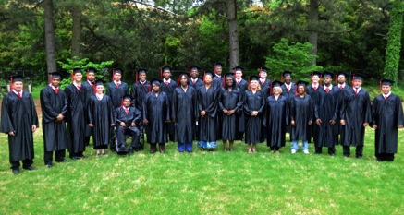
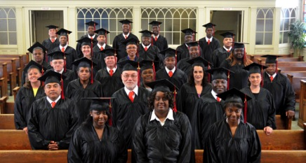
1 Year VICTORY PROGRAM
Fall Victory Graduation
Spring Victory Graduation

Slide 7
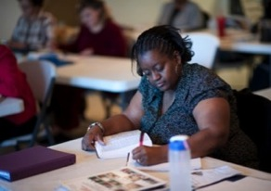
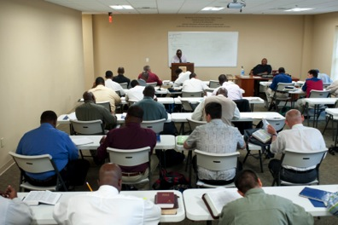
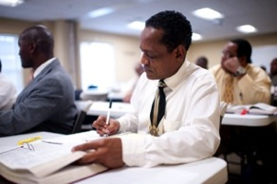
THE VICTORY PROGRAM
Victory Program: Phase I
Learning a Better Way

Slide 8
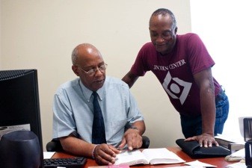
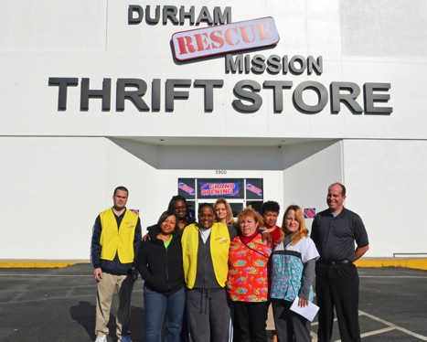
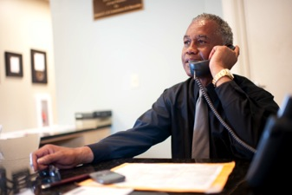
THE VICTORY PROGRAM
Victory Program: Phase 2
Accountability

Slide 9
WORK READINESS PROGRAM
In 2015, Through our Temporary Employment Agency, Temps to the Rescue . . .
215 People Got Jobs!
Almost $1m Salaries

Slide 10
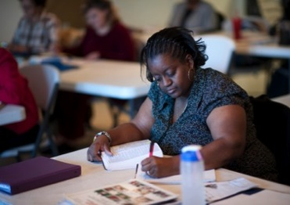
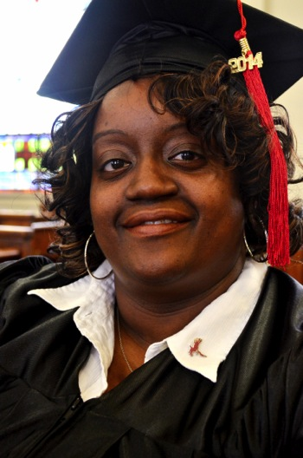
OTHER EDUCATIONAL PROGRAMS
Chanda Drayton is a Senior at NCCU studying Family and Consumer Sciences with a concentration in Early Childhood Education, while at the Mission.
Chanda’s Victory Program Graduation Portrait

Slide 11
OTHER EDUCATIONAL PROGRAMS
Automotive Systems Technology
Durham Technical Community College gives Durham Rescue Mission residents a scholarship fund to continue their education in the Automotive Systems Technology program.

Slide 12
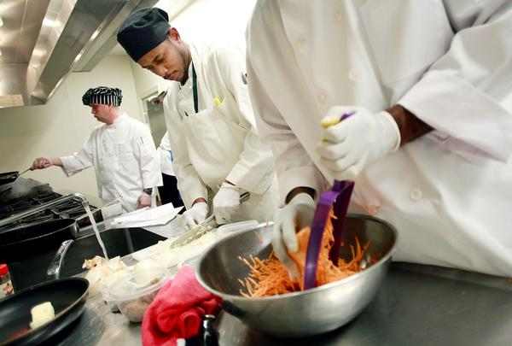
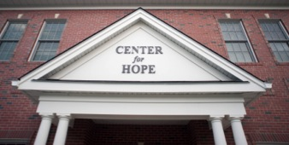
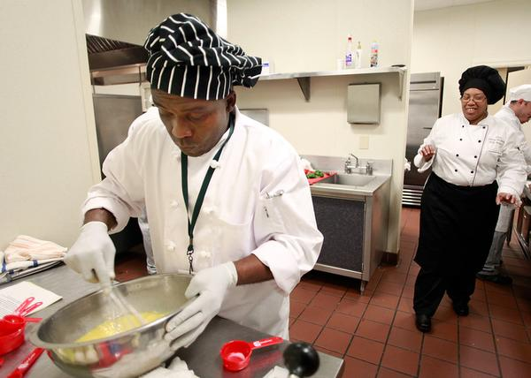
OTHER EDUCATIONAL PROGRAMS
The Durham Tech Culinary Arts Program is held in our
Center for Hope Kitchen!

Slide 13
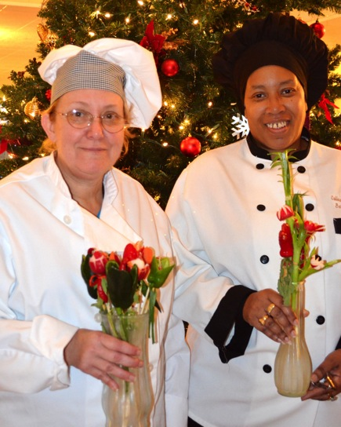
OTHER EDUCATIONAL PROGRAMS
Shelia Joyce, a Victory Program Graduate now employed with the Durham Fire Marshall’s Office, graduated from the Durham Tech Culinary Arts Program and now volunteers at our Women, Children, and Families Division, assisting in cooking meals and desserts!

Slide 14
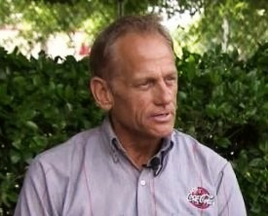
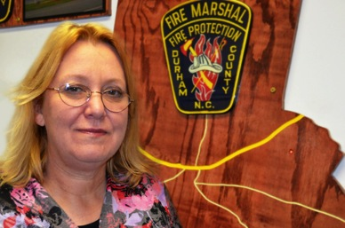
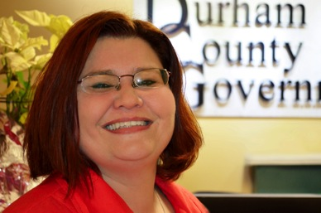
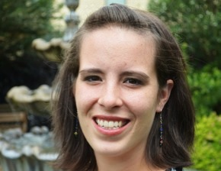
JOB PLACEMENT
Shelia Joyce
Durham County Fire Marshall’s Office
John Rush
Durham Coca-Cola
Liz Wrenn
Costco in Durham
Deli Assistant
Karen Ramsey
Durham County Tax Assistant

Slide 15
Community Events

Slide 16
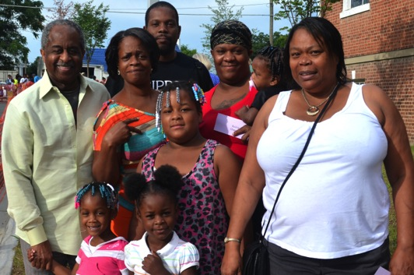
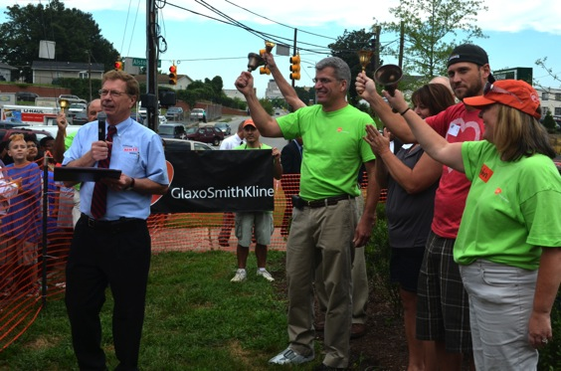
COMMUNITY EVENTS
Mayor Bill Bell with a Family from the community at our Back to School 2013 Event!
GlaxoSmithKline Senior Vice President, Jack Bailey, ringing the bells at our Back to School 2013 Event!

