Slide 1
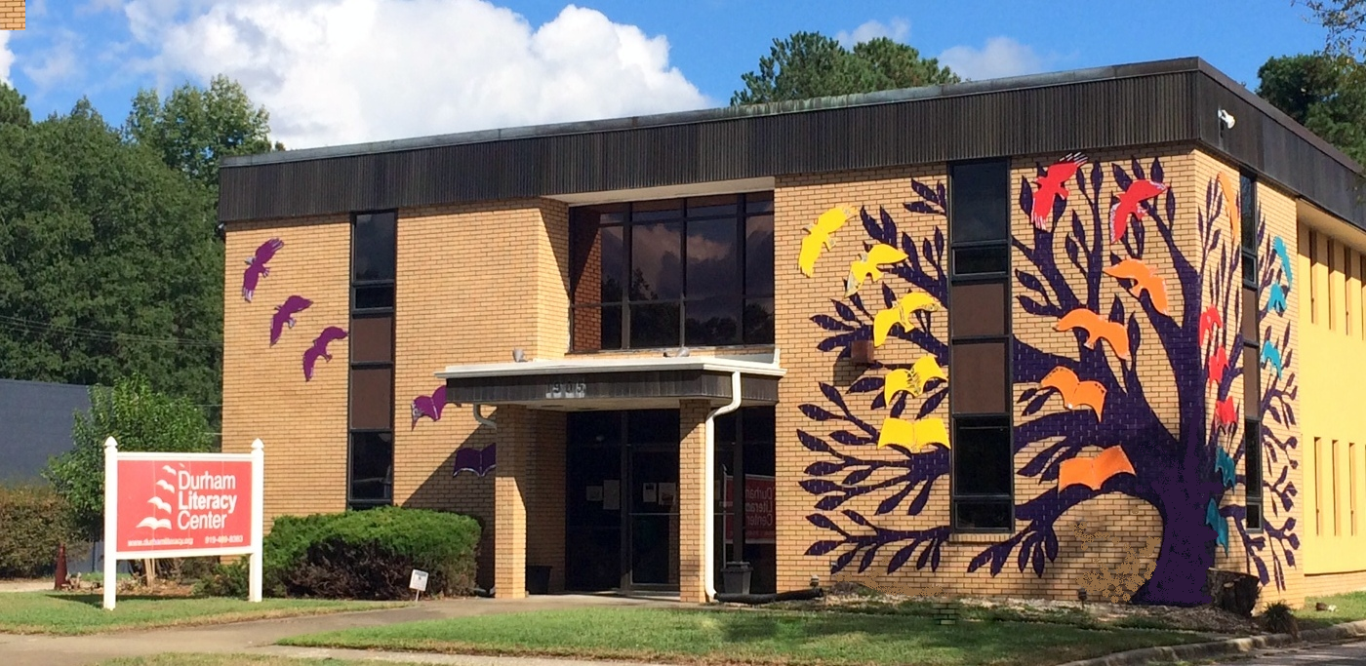
Celebrating 30 Years
of Empowerment

Slide 2
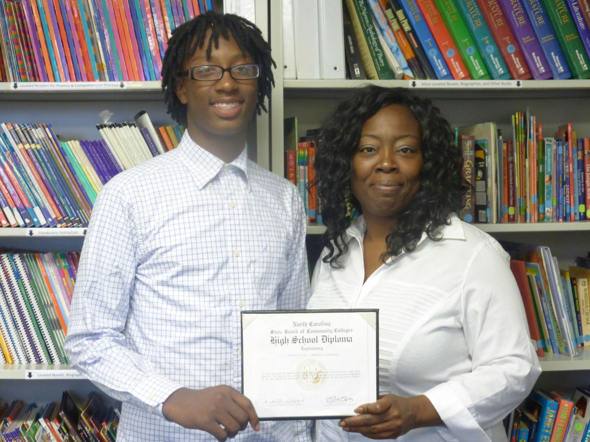
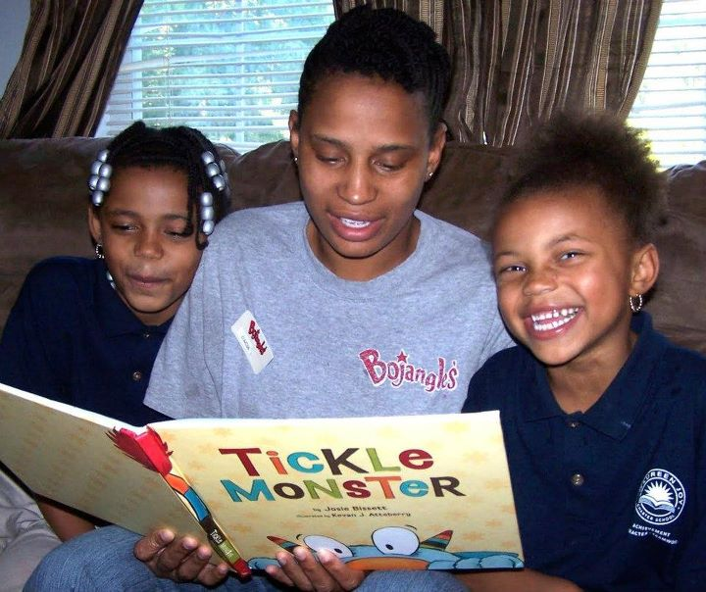
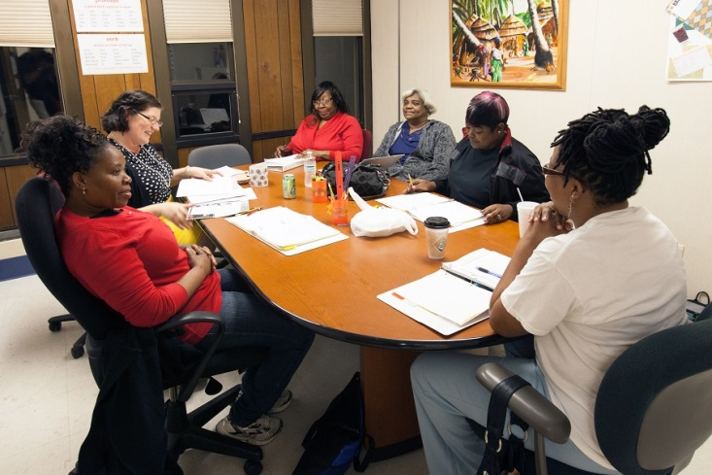
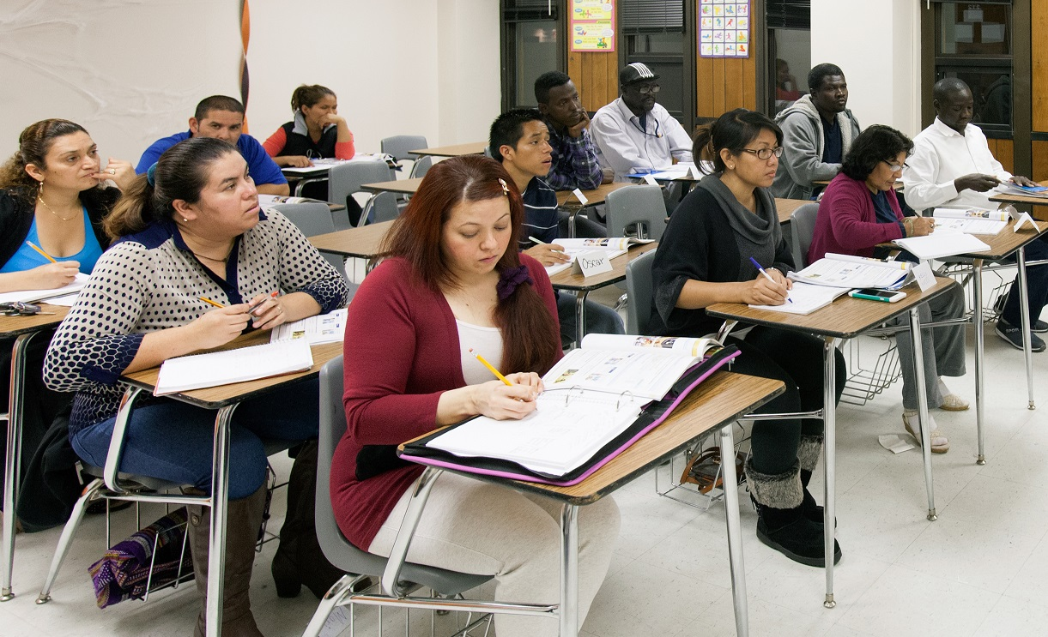
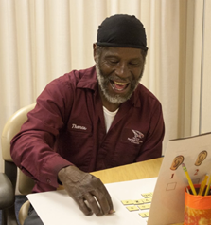
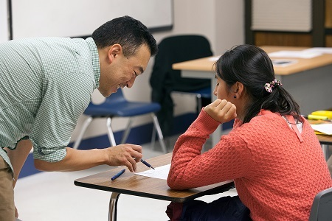
As Durham’s leading, independent adult literacy provider for more than 30 years, the Durham Literacy Center is vital to our community’s well-being.
2

Slide 3
DLC Quick Facts
Our mission is to empower Durham County residents who want to enrich their lives and the lives of their families by improving their literacy skills.
Our programs, tuition-free and taught mostly by volunteer tutors, serve students at 10 sites around Durham and touch on every aspect of literacy, including digital, health, financial, civic, and job- related literacy.
Our students are Durham adults and out-of- school youth who seek to improve their lives by learning to read, write and speak English.
Our volunteer tutors participate in a comprehensive training program and are supported by expert program staff.
4

Slide 4
Literacy Facts
Up to 20% of Durham adults lack “basic prose literacy”
15% of adults in the US cannot read, write or do math above a third-grade level
Adults without basic literacy skills earn an average $28,000 less per year
1 in 6 students drop out of high school every year
Low adult literacy costs the US $232 billion in health care plus $225 billion related to unemployment.
A mother’s reading skills determines her child’s success in school

Slide 5
Impact & Success in 2015
Over 650 students were enrolled in all DLC programs
85% of Adult Literacy students reported increased confidence in reading
ESOL classes are offered at six different levels at seven sites around Durham
73% of beginning-level ESOL students tested improved their reading comprehension
85% of YEP students tested improved their reading and/or math skills
More than 100 DLC volunteers provided approximately 10,000 hours of instruction
Over 50% of the students we served either obtained or retained a job, and many received promotions

Slide 6
DLC Program Overview
English for Speakers of Other Languages — Trained tutors provide English language instruction to students from more than 40 different countries. Group classes offer a mix of listening, speaking, reading and writing skills, and incorporate job readiness with a practical real-world focus.
Adult Literacy — Trained tutors work one-on-one with students, teaching basic literacy skills to adults, most of whom are at or below a third-grade reading level. Staff and volunteers also teach pre-GED and GED classes.
Youth Education Program —Tutors work one-on-one with out-of-school youth, ages 16 to 24, to prepare them for high-school equivalency exams, work, vocational training and postsecondary education.
Computer Literacy — DLC staff and volunteer tutors provide hands-on computer literacy training with a focus on real-world applications.
The GED and Life Skills/Job-Readiness Program at the Durham County Detention Center includes two primary instructional areas: education (GED and basic skills) and life skills (job-readiness development). The programs are offered to incarcerated youth ages 16 to 24 who lack a high school diploma.
Career Pathways Workshops — DLC staff and partners provide interactive sessions on career-readiness topics.
Threshold — DLC staff offer weekly literacy and math instruction to adults with mental illness.
5

Slide 7
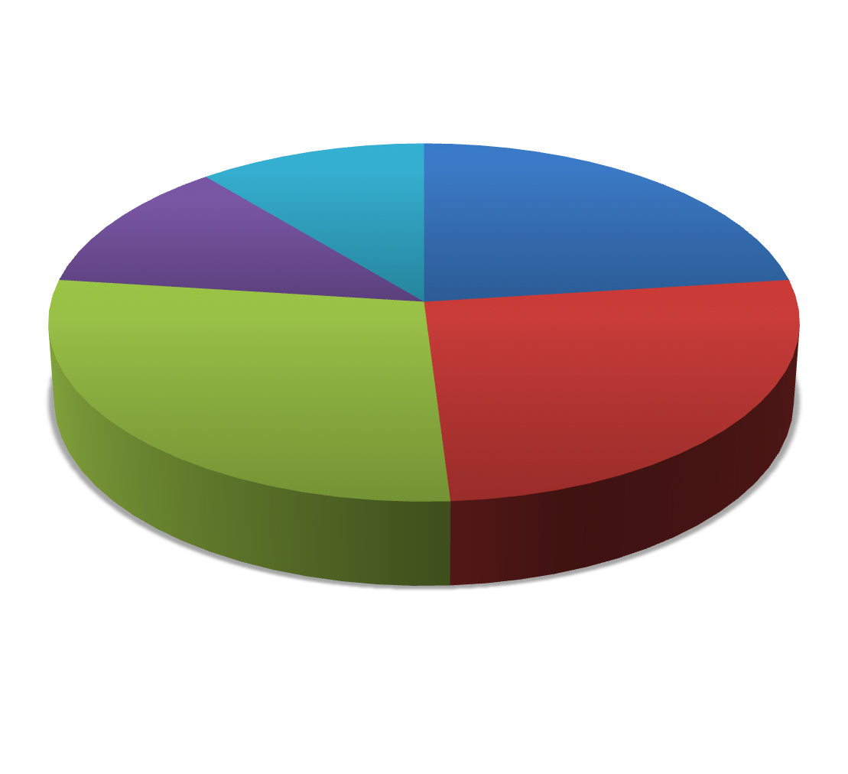
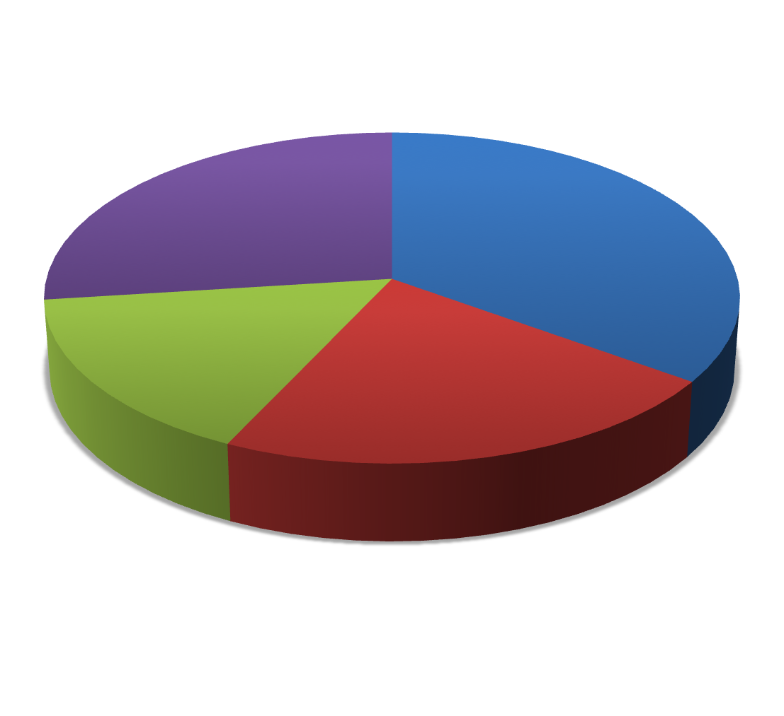
Finances (Fiscal Year 2014–2015)
How we raise money*
Program Generated
Revenue 11%
United Way 12%
Government
23%
Trained volunteer tutors provide the majority of our instruction, making our services economical and cost-effective
Fifty-four percent of our funding comes from the generosity of individual, foundation, and corporate donors
Seventy-eight cents of every dollar is spent directly on educating students
Cost per student is $700
Individual & Corporate Donations
26%
Foundations
28%
How we spend money
Management &
Fundraising 27%
Adult Literacy
35%
YEP
16%
ESOL
22%
*Revenue is based on a cash budget of $468,000 in 2014-15, prior to contract in Durham County Jail..
6

Slide 8
Youth Education Program
YEP Program Highlights
57 tutors gave 1,262 hours of service
36 students completed 2,534 hours of academic preparation
Continued to upgrade our curriculum to help students learn the skills and knowledge required to pass the GED and succeed in their future academic endeavors
Helped YEP students explore career options, write resumes, search and apply for jobs, practice for interviews and advocate for themselves as employees
YEP is a learner-centered program targeting out-of-school youth ages 16 to 24 who left high school and are studying to earn their equivalency diplomas (e.g. GED).
YEP pairs students with volunteer tutors and provides individualized lesson plans to review material, teach new skills and fill knowledge gaps.
YEP staff work with tutors to find each student’s best learning style, emphasizing the reading, writing, computer and math skills students will need to pass the test, obtain employment and pursue vocational or postsecondary education.
8

Slide 9
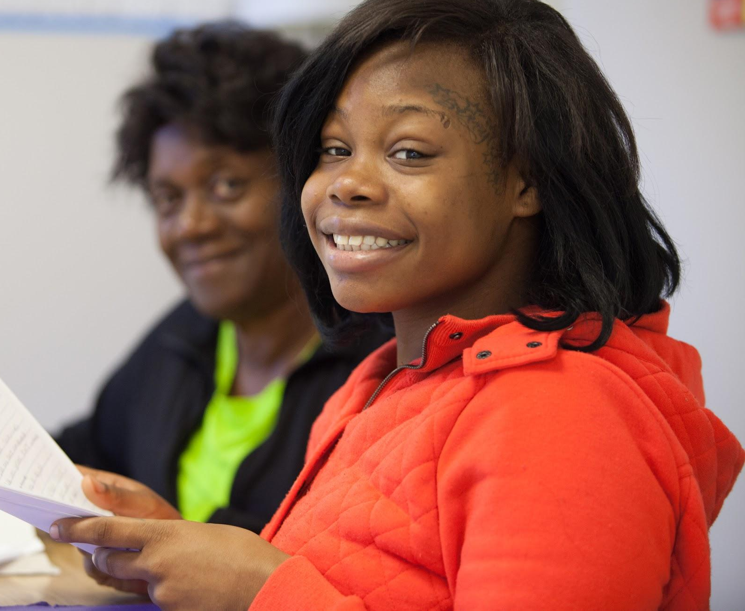
YEP Student Highlight: LaShawn Gonsalves
21 years old
Mother of two
Dropped out of school at the age of 16
Received GED diploma in August 2016
Goal: Registered Nurse
Status:
Currently working on Certified Nursing Assistant certification
Plans to enroll at Durham Tech in January 2017
“I’m very grateful for the DLC because it’s always a positive environment where I can get support and encouragement. This school has opened my eyes to more opportunities. I plan to get my GED and then attend college. I want to go into the medical field and become a Registered Nurse. I never liked school, but now I love coming to class every morning. My teachers give me hope and I am surrounded by positive vibes from people who actually want the best for me.
There is no limit to what I can do.”

Slide 10
English for Speakers of Other Languages (ESOL)
The ESOL Program helps adult refugees and immigrants develop English proficiency and prepare for the world of work in the US.
Classes cover real-world themes such as helping children in school, housing, health care, career training and education.
We offer career-readiness preparation, including career-specific workshops and job specific language skills, resume building and finding a job. We look for career mentors to help students find the jobs they need and want.
ESOL offers 17 different classes at 7 sites around Durham, including four Durham County Library branches.
Some students must first learn a new alphabet, or to read and write. Many are improving their basic English skills, while others need higher-level English to finish high school, enroll in college or train for a secure job.
Partner sites include four libraries, El Centro Hispano and East Durham Children’s Initiative (EDCI).
ESOL Program Highlights
Served more than 400 students from 40 different countries
Provided career-readiness classes and workshops
Supported 81 volunteers who provided 2,000 hours of ESOL instruction
50% percent of post-tested students demonstrated improved reading comprehension
More than 75% of ESOL students reported progress toward a personal goal
68 refugees received assistance integrating into the Durham community

Slide 11
ESOL Student Highlight: Zakariya Abdullah
29 year old Iraqi Kurd and refugee
Married, no children – wife is also enrolled in ESOL classes
Arrived in Durham in 2015
Worked as an interpreter for the US Army in Iraq, but still not good enough to allow him to read, write and compete with a native speaker at a high-school level.
Goal: Doctor
Status:
Working as a housekeeper at a big Durham hotel.
Finished a Certified Nursing Assistant program and is prepping for the state test.
“It’s been frustrating, but also exciting,” Zak says. He knows he must “start at the bottom” and work his way up. He studied to be a librarian in Kurdistan, but his dream has always been to become a doctor. Hotel housekeeping is not what he wants forever, but he’s grateful that with hard work he can do what he wants.

Slide 12
Adult Literacy
Adult Literacy Program Highlights
Served 159 students
Over 60 newly trained volunteers delivered basic literacy, pre-GED and GED instruction
Several students studied for and passed one or more official GED tests
Students reported increased confidence in reading settings beyond the classroom
Several students reported reading a book for the first time and sharing it with family and friends
Started a pilot program offering basic literacy instruction to three TROSA residents
Designed to equip adults with reading and writing skills that empower them to reach their full potential in all areas of life—home, work and community.
Research-based curriculum and one-on-one and small-group instruction helps students achieve numerous personal goals, including obtaining employment, making informed decisions about health care, registering to vote and advocating for their children in school.
These efforts improve students’ confidence, relieving them of the stress and shame that is associated with low-level literacy.
Intermediate-level readers are offered small group classes that provide evidence-based reading instruction.
We also provide one-on-one tutoring for adults who want to prepare for high-school equivalency tests such as the GED.

Slide 13
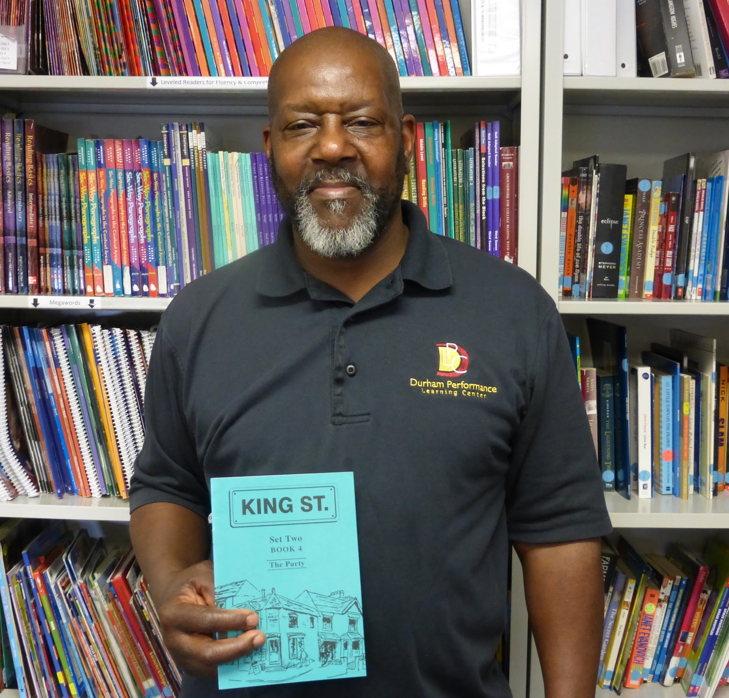
Adult Literacy Student Highlight: Paul Hunter
62 years old
Proud father and grandfather
Born and raised in Durham
Graduated from high school and worked at local universities and schools for more than 40 years before learning to read.
Meets with volunteer tutor twice a week for 1 1/2 hours each session
Has dramatically improved his encoding and decoding skills
Goal: Own flooring business and travel
“Some people I know told me to come to the Durham Literacy Center to get help with my reading,” Paul recalls. “I’ve been here since then. I felt happy when I came here because I knew I was going to get some help.”
Paul is one of our most dedicated students. He meets with Martha, his tutor, twice a week for an hour and a half. They work on sounding out words in order to read and spell. “I never miss a lesson, unless I’m really sick, and that’s not very often,” says Paul. “I learn something new every time.”
Paul wants to use his reading skills to read the street signs as he travels. He is making progress toward that goal.

Slide 14
Computer Literacy
Beginning computer classes and one-on-one instruction for more advanced students
Computer lab available for students and community members for job searches, and others apply to colleges, work on lessons or practice their reading.
Computer literacy skills are critical for employment, connecting with community and government resources and staying connected to family and friends.
Applying for many jobs now requires a degree of familiarity with the internet and email. Anyone taking the GED now must be familiar enough with computers to take an online test.
Bridging the “Digital Divide” is no longer simply a matter of increasing access to computers. It also includes teaching students the skills necessary to use computers and the internet to reach their fullest potential.
CL Program Highlights
Provided more than 750 hours of instruction to 48 individuals
Served advanced students with 1-on-1 instruction in topics such as finding a job, setting up online accounts, and learning to browse the internet safely
Partnered with Teaming 4 Technology at the United Way to connect students who completed the program with low-cost desktop and laptop computers
Assisted more than 100 people in our public labs where patrons worked on job searches, checked email, worked on school projects, and practiced typing
14

Slide 15
Partnership Highlights
The Durham Literacy Collaborative is a new comprehensive approach to improving educational and economic outcomes for Durham families. The DLC is working with the Achievement Academy of Durham, Motheread, and the Durham County Library to provide literacy instruction to both parents or other caregivers and their children. The goal is to break the inter- generational cycle of low literacy and poverty by educating parents and children together. The GED and Life Skills/Job-Readiness Program at the Durham County Detention Center includes two primary instructional areas: education (GED and basic skills) and life skills (job-readiness development). The programs are offered to incarcerated youth ages 16 to 24 who lack a high school diploma. | ESOL for Parents and Caregivers is provided in partnership with the East Durham Children’s Initiative (EDCI). We now have two ESOL classes at EDCI. Parents learn English while their children participate in child development, literacy enrichment and other activities. In addition, families receive wraparound intensive programming to achieve the maximum impact. Project LIFT (Lifelong Investment in Future Talent) is a project of the Durham Literacy Center, Durham Economic Resource Center and Urban Ministries of Durham. The mission of LIFT is to empower Durham’s most vulnerable adult population — those struggling with homelessness — by providing basic literacy and health, financial and job-readiness skills. The goal of the project is for all participants to attain living-wage employment and permanent housing.
16

Slide 16
1905 Chapel Hill Road
Durham, NC 27707
(919) 489-8383
www.durhamliteracy.org

